Slide 1
Social Justice, Equity
and Service Learning
in
MYP & DP Eric Robertson, Tanay Naik TFS – Canada’s International School

Slide 2
Why are we here?
Notes:
Tanay - will intro as we go
What brought you here?
Why are we here? Why we care? What we’ve learned based lived experience.
We are clearly very well-connected in IB circles to have gained this prime time spot in the program.

Slide 3
Suzanne’s story
Notes:
Eric to introduce Suzanne
Why I’m here presenting on this topic this morning is due in large part to Suzanne Fish, a aluma of our school, whom I came to know last year and who served as a real catalyst for my own growth in how I approach service learning and how I plan this with colleagues and facilitate it with students.
So we begin with Suzanne’s story before sharing how I applied this to my own work with MYP and in turn Tanay with our DP.
While Suzanne couldn’t be here, she will act as our (invisible) co-presenter through audio screenshot -
May be an IB conference first - show video

Slide 4
Something to think about…
What are some possible factors that might account for the ineffectiveness?

Slide 5
How does this message of being an ally connect to Wab Kinew’s address on Thursday evening?
How are you, or could you and your school community be an ally?

Slide 6
Take-aways
To what extent are naming and defining terms important to our approaches to ‘service learning’?

Slide 7
IB Learner Profile
What attributes connect to ‘service learning’?
Notes:
Anyone here French or Spanish speaker and familiar with LP attributes in these languages?

Slide 8
IB Learner Profile
Caring
Altruiste (French version)
Solidario (Spanish version)
Notes:
Get logo for MYP & DP

Slide 9
MYP Development
Community Service Community and Service
Service as Action
Personal Project Community Project

Slide 10
IB programme standards and practices
Standard A: Philosophy
developing and promoting international-mindedness and all attributes of the IB learner profile across the school community
promoting responsible action within and beyond the school community
promoting open communications based on understanding and respect
Standard C3: Teaching and learning
engaging students as inquirers and thinkers
building on what students know and can do
supporting students to become actively responsible for their own learning
addressing human commonality, diversity and multiple perspectives
using a range and variety of strategies
developing student attitudes and skills that allow for meaningful student action in response to students’ own needs and the needs of others

Slide 11
IB Resources
IB OCC IB Continuum of International Education
Global Engagement (Good Practice Guides)
Going Beyond the Bake Sale: Becoming more locally, globally engaged
In the MYP community project, service can be:
direct (for example, tutoring or serving at an animal shelter)
indirect (for example, redesigning a website or developing educationalmaterials)
advocacy-focused (for example, initiating awareness campaigns about cyberbullying or sustainable energy use)
research-oriented (for example, collecting data to influence policy or practice, such as environmental surveys).
MYP global contexts and key concepts like communities, global interactions and systems can help students to develop their understanding of civic participation.
(IB Continuum

Slide 12
In the MYP community project, service can be:
direct (for example, tutoring or serving at an animal shelter)
indirect (for example, redesigning a website or developing educational materials)
advocacy-focused (for example, initiating awareness campaigns about cyberbullying or sustainable energy use)
research-oriented (for example, collecting data to influence policy or practice, such as environmental surveys).
MYP global contexts and key concepts like communities, global interactions and systems can help students to develop their understanding of civic participation.
Notes:
Cathy Berger

Slide 13
“Principled action...represents the IB’s commitment to teaching and learning through practical, real-world experience. IB learners act at home, as well as in classrooms, schools, communities and the broader world.
IB World Schools value action that encompasses a concern for integrity and honesty, as well as a strong sense of fairness that respects the dignity of individuals and groups. Principled action means making responsible choices, sometimes including decisions not to act”.
What is an IB education? (2013)
I
Notes:
Ethics of actions
Inclination for Saviour -
Rambo-style
Learning - choice

Slide 14
Eric’s story

Slide 15
Background
Born in US, grew up in Dundas , Ontario (outside of Hamilton)
Lived in Europe
International School in Switzerland
Private Schools here in Toronto
Going into Public school setting
My own kids
Service learning involvement
Notes:
Health food cooperative in 70’s
Now:
Comm. service project on Wednesday -

Slide 16
My Past Experiences

Slide 17
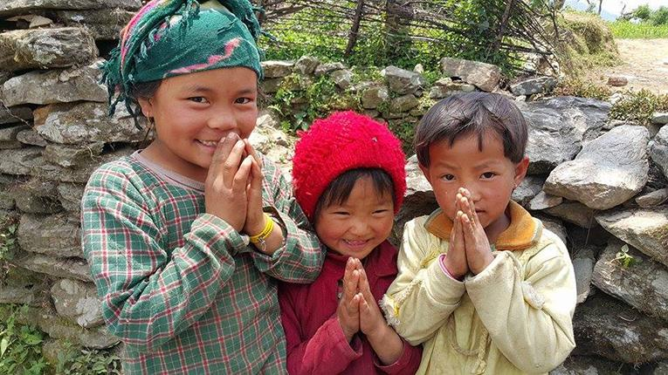
School Trip: Trekking in Nepal
“They having nothing
but are so happy.
I realize how fortunate I am.”
Notes:
Group of 20 of us trekking in the Himalayan foothills with an entourage of 40. They were those who carried our bags, those who cooked for us, those who led us and looked out for us (even standing watch while we slept).
Remote and destitute places
Certainly dignitiy and respect
Fascinated by our students technology - video cameras, etc. in 1990’s. Give out pencils (needed these to learn).
Painted a shelter for children fleeing abuse and child prostitution.
Celebration evening - was touching - but the most common refrain from our students was: this line.

Slide 18
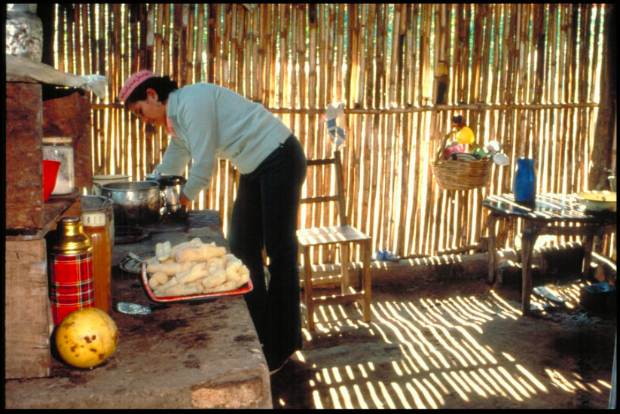
Helene Tremblay - Families of the World
One day, I followed Catalina as she was going to milk the cow at her mother-in-law’s next door. Going back through the fields toward Catalina’s house that didn’t have electricity and still had an open air well, Catalina said to me: “Helene, don’t you think my house is beautiful?” I said: “Oh yes, it is really very beautiful.”
Notes:
Many people turn the pages of the Families of the World book and look at the people saying: “These ones are poor, these ones are rich,” as if that was the only way to look at the world. That cane wall was not a poor person’s wall.
It was simply a beautiful wall of light; a wall that belonged to Catalina, who loves the light just as you and I do. It was the wall of a woman with the heart of an artist who likes to have beauty in her life.
http://letsmeetontheearth.org/beauty-paraguay/
Impose our own pre-conceptions based on embedded values - lens

Slide 19
Notes:
Each homeroom class will be going to the Bridges for Youth Centre, which provides support for street-involved and at-risk youth. There the students will be involved in a workshop, including a street walk to understand better the experience of homelessness, especially for youth, and the related issues including mental health, addiction, sexuality and aboriginal issues.

Slide 20
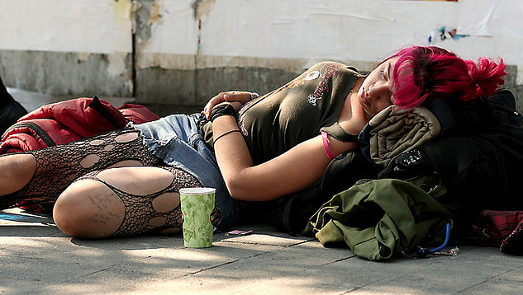
Street Youth in Toronto
http://torontoist.com
http://jfcy.org/en/street-youth-of-toronto/
Notes:
Each homeroom class will be going to the Bridges for Youth Centre, which provides support for street-involved and at-risk youth. There the students will be involved in a workshop, including a street walk to understand better the experience of homelessness, especially for youth, and the related issues including mental health, addiction, sexuality and aboriginal issues.

Slide 21
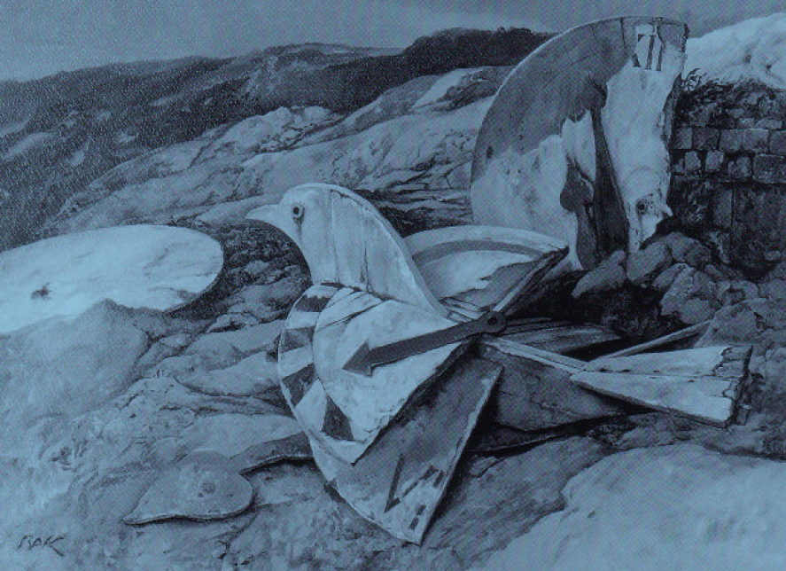
Individual & Societies Teacher
Facing History and Ourselves: Holocaust and Human Behaviour
“All the people like us are we, and everyone else is they.”
Rudyard Kipling
Notes:
Suzanne’s message reinforced my use of one very powerful resource:
Our mission is to engage students of diverse backgrounds in an examination of racism, prejudice, and antisemitism in order to promote the development of a more humane and informed citizenry.
By studying the historical development of the Holocaust and other examples of genocide, students make the essential connection between history and the moral choices they confront in their own lives.
Simple as looking at exclusion at school, bullying, role of the victim, perpetrator, bystander
Use of poetry, short stories

Slide 22
Present
Engaging with communities and individuals who have been marginalized
First Nations
Immigrants
Youth Philanthropy Initiative
Personal Project
Notes:
Unit 2: First Nations literature
MYP unit questions: How do people advocate for themselves under duress? How do we maintain our culture / identity in the face of adversity?
October to December
This unit examines the writing and experiences of Aboriginal people in Canada, beginning with the journals of Sepeetza, a student at a residential school during the 1950’s. Issues of compassion, persecution, culture, and identity will be explored through literature, talks by guest speakers, and through a tour of a residential school. Students will be asked to think critically about how stories and history allow us to remember our pasts and express ourselves as humans.
Skills: research, making citations, ACE (assert, cite, explain), presenting an argument and responding to opposing points, collecting evidence, thinking critically, considering the perspectives of others, editorial writing, the writing process (brainstorming, draft writing, editing, final draft)
Assessment FOR Learning: Editorial in which students take different perspectives on education during the time of Sepeetza
Assessment OF Learning: Class debate on environmental issues, education, and health services based on research and our novel study
Math - If the World were a village
English - Wonder - R. J. Palacio, The Pigman, Paul Zindel
Kim’s Convenience - Ladder of inference -
Worldvuze -
Personal Project - highlighting mental health issues, LGBT
Students are asked to visit a charity and learn more about the necessity of this charity within our community. Through both the YPI presentation and the creation of a short story, students are asked to use self-expression, to analyze and reflect on their role and the needs of others. Direct connections are made between the choices we make in response to our communities, and the consequences of these choices, both in fiction and in reality.

Slide 23
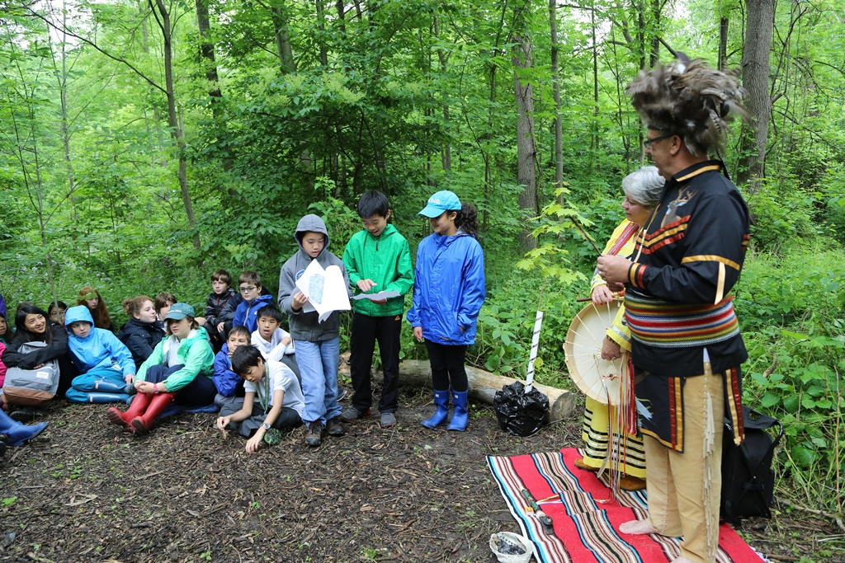
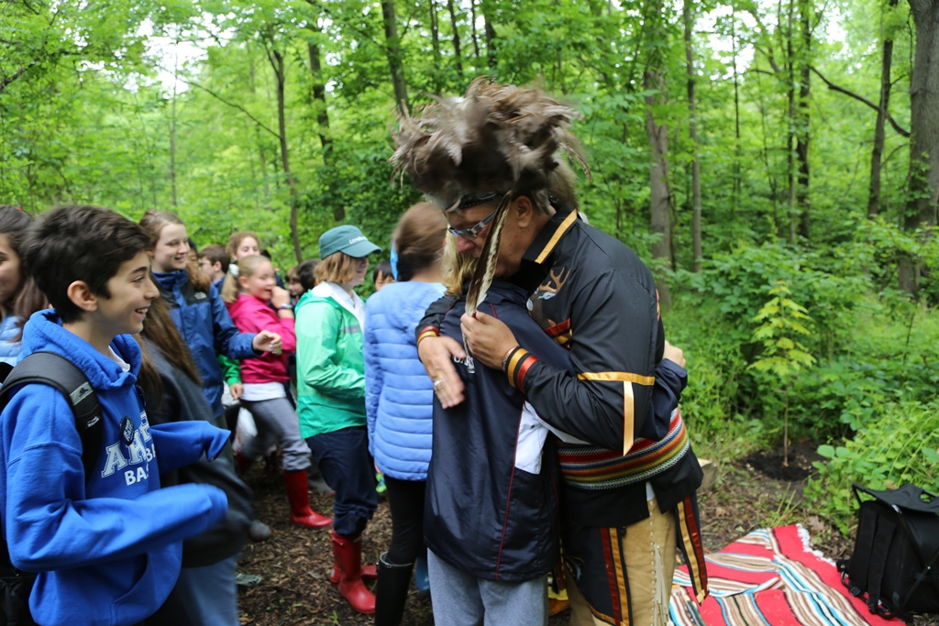
Notes:
In response to Truth and Reconcilation Commission Report in June, 2015
Ceremony, Indigenous elders, planting of a tree - symbolic gesture, commemorative value, contribute to our eco-system, which is viewed as sacred in Native spirituality

Slide 24
Outreach Day
Examples:
Aboriginal Legal Services
Bike Pirates (service provider)
Mining Injustice Solidarity Network (advocacy group)
Rittenhouse (prisoners)
Tangled Art (physically disabled)
Working for Change (mental health)
Before:
More doing
After:
More understanding directly from those marginalized
Notes:
Before: food bank, shelter, care facility for seniors
In connecting to Suzanne’s message,
What would you imagine to be the benefits, limitations/downsides?
Honoraria - workshop - afterall it’s about our learning as much as us doing service for others

Slide 25
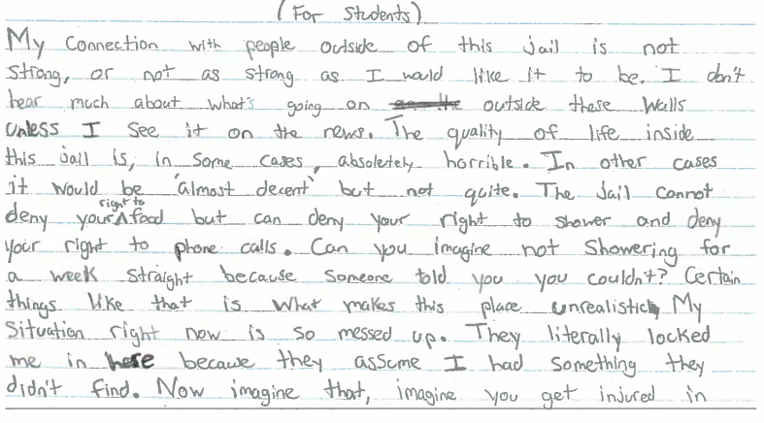

Slide 26
Next Steps
More authentic/real world opportunities
More inquiry-based, collaborative, open-ended
Inquiry/challenge
investigation/planning
Action/Solution
Reflection/Next Steps
Find a balance between understanding and action
Developing a continuum of developmentally appropriate learning
Fostering long term relationships
Notes:
Reference Cathy Berger

Slide 27
What’s your professional journey/story?

Slide 28
Discussion
In what way has your approach to service learning changed? Either personally or in your school?

Slide 29
Tanay’s Service Learning Professional Journey

Slide 30
My background
IB Diploma Graduate - year 2000. Started at the International School of Bangkok, but finished the DP at the International School of Kuala Lumpur.
Attended the International School of Manila, UNIS-Hanoi, International School of Bangkok and International School of Kuala Lumpur
Service for CAS completed by being a volunteer basketball referee and coach and Habitat for Humanity in Chiang Mai, Thailand
TOK, History and English teacher and CAS Coordinator at Branksome Hall
Now the DP Coordinator/TOK Curriculum leader at TFS - Canada’s International School
Member of IBEN and TOK Examiner

Slide 31
How has the DP acknowledge the need for these changes?
The move away from ‘number-counting’ for the completion of CAS. (no longer a clear 50/50/50 split between the 3 strands)
Introduction of Learning Outcomes
Renewed emphasis on reflection.
The CAS project.

Slide 32
Learning Outcomes
The move to meeting learning outcomes for CAS really emphasizes more of the holistic approach to co-curricular events.
Some of the outcomes have very clear and specific implications for how students see and interpret service learning (Ethics).
How can we connect a very challenging outcome to negotiate, Ethics, and have students reflect on it meaningfully?
Bringing service learning into the classroom - Geography, TOK, Science, etc.

Slide 33
What we do at TFS...the LTSP
1. Determine a social need in the GTA that you are interested in solving/learning more about.
2. Investigate the issue finding out as much as you can about it
3. From there, determine nonprofit organizations that work to address this need.
4. Contact those places to determine if they are appropriate for you to volunteer.
5. Set up project in ManageBac seek approval Volunteer
6. While volunteering, reflect on what needs to happen next. How can YOU be active beyond the organization and TFS to address this issue? Take 1 step to do something.
The Long-Term Service Project (LTSP).
The LTSP is a key component in successfully completing the Service component of CAS. It will not be the only service activity you undertake but it must be one of them.
The LTSP must be with a nonprofit organization in the GTA and occur over a minimum of 4 consecutive months. All LTSPs must begin in DP1. Following are suggested steps for engaging this project:

Slide 34
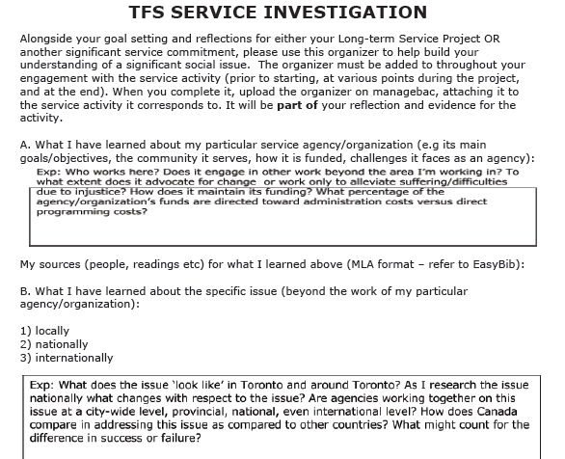
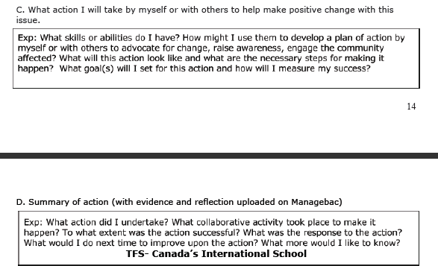
LTSP - Service Investigation Form

Slide 35
jericrobertson@gmail.com
tnaik@tfs.ca

