Slide 2
Creating Authentic Units to Motivate Learners
Presented by Peter Swartley and Jesse Lang

Slide 3
Getting to know you
We will use Plickers to learn a little bit about you.
Please pick up paper that has black and white squares on it.
Rotate the sheet of paper, so that your response e.g. “A” is facing up.
P

Slide 4
What is meaningful learning?
Take a minute: Think back to when you were in high school about a unique project that you still remember today. What made it different? What made it unique? For me it was a WWII project.
Introduce yourself and share with a neighbor a meaningful learning experience that you have had. If you never had one or it was a long while ago, perhaps it could be one that you have experienced as a teacher or administrator.
J

Slide 5
“Learning from each other” Bob Poole
Once this conference has ended and you have returned to your home what are you going to implement or change in your programme?
Our intention is for you to learn from us and bring it back to your school.
P

Slide 6
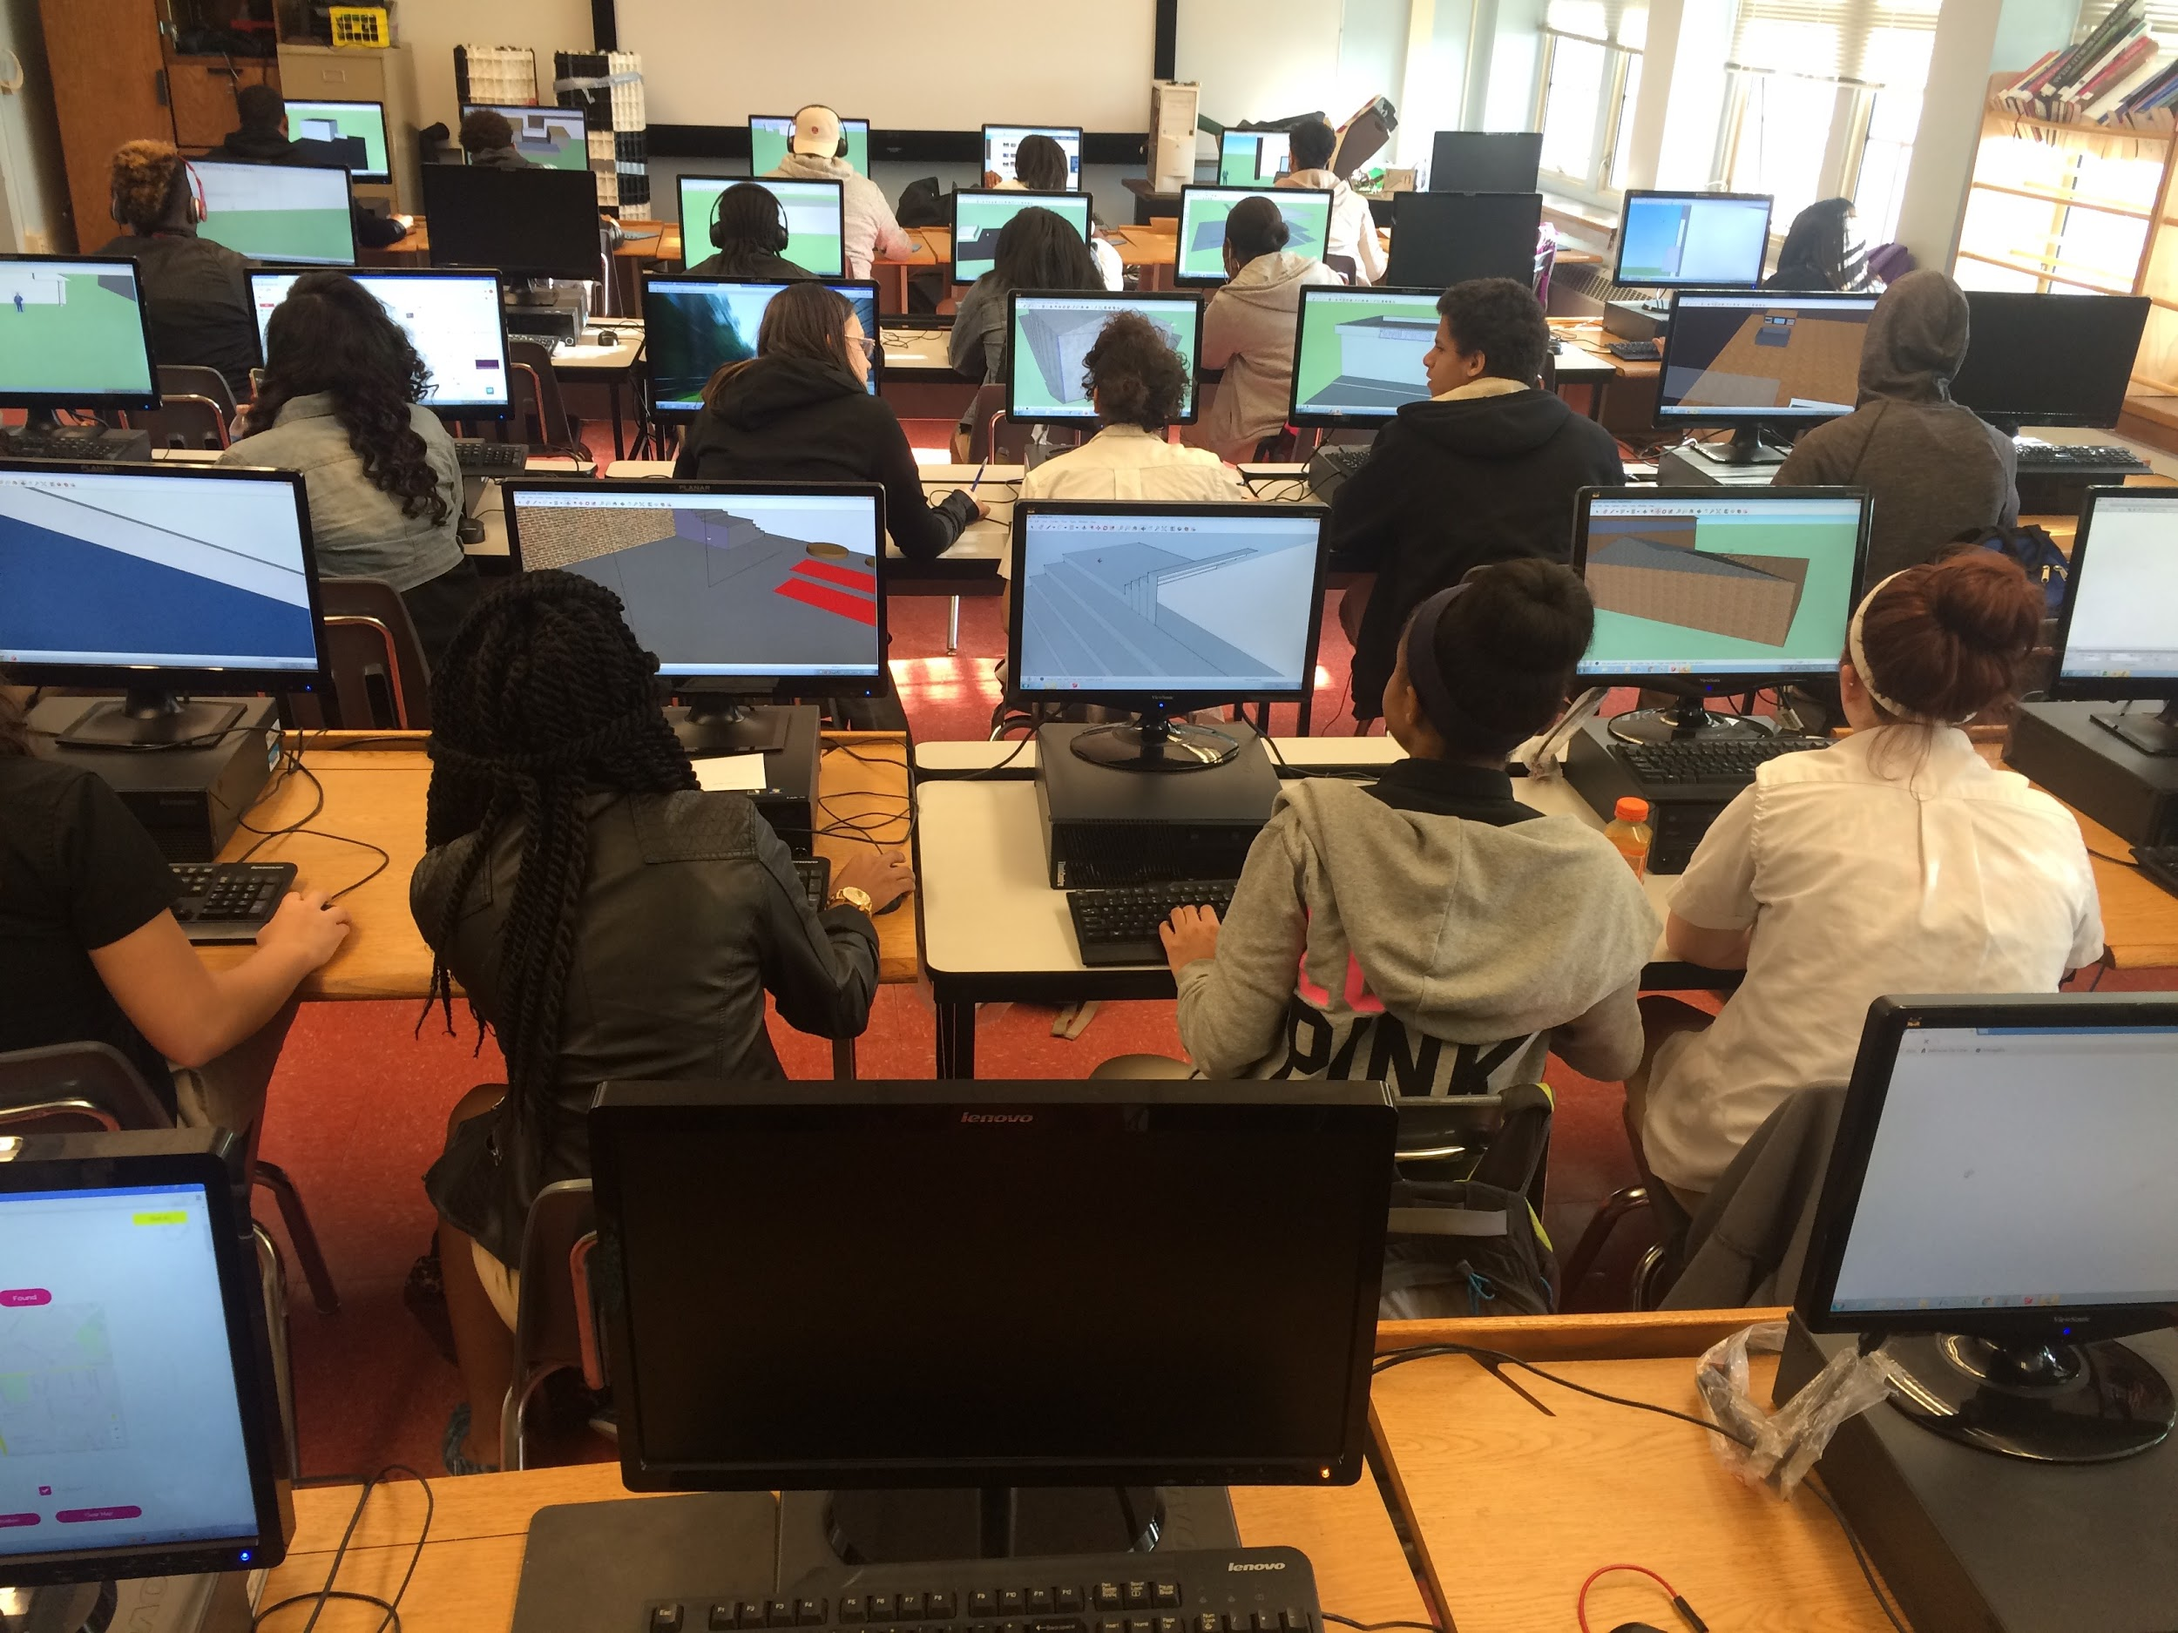
Background of our authentic project
Needed to be Free!
Evolution:
Use sketchup to create objects -> House-> renovations -> community design -> ??
Writing class +Current issue Gov. Hogan’s plan+ Willingness to expand= change
J

Slide 7
Why authentic?
From principles into practice (2014)
Course aims and programme requirements offer authentic opportunities to learn about the world in ways that can reach beyond the scope of individual subjects through interdisciplinary learning (pg 13).
In the MYP, learning contexts should be (or should model) authentic world settings, events and circumstances (pg 18).
As students try to create meaning in their lives and the world around them, they will continually construct, test, confirm or revise their personal models of how the world works and their personal values (pg 43).
The MYP encourages teachers to provide opportunities for students to build meaning and refine understanding through structured inquiry… within the classroom or beyond (pg 43).
P

Slide 8
What is authentic?
Anthony and Jane Herrington
Fred Newman et al.
“a realistic problem preserving the complexity of the real-life setting”
“complex and sustained, requiring intensive effort”
“real-world relevance, and which present complex tasks to be completed over a sustained period of time”
“even highly active students can produce work that is intellectually shallow and weak”
Everyone constructs meaning, so education is to “improve the quality of meanings we construct”
authentic academic achievement measured through three criteria: “construction of knowledge, disciplined inquiry and value beyond school”
P

Slide 9
Examples from some of our colleagues
MYP Chemistry
You are a scientist working for the Food and Drug Administration (FDA). Your job is to calculate the calorie contents of food products to verify information submitted by the manufacturing companies. Since the FDA oversees the approval of food products, your work will be used to verify the safety and efficacy of these products for consumption.
P

Slide 10
Examples from some of our colleagues
Theory of knowledge
You are an atheist who wants to attend a religious-affiliated university because it offers wonderful study abroad programs, but priority is given to students who belong to any type of religion. Your job as an atheist student is to convince the admissions board with arguments as to why religion should not play a role in the admissions process and the sometimes negative impact of using religion to make decisions.
P

Slide 11
Examples from some of our colleagues
DP Language acquisition - French
In March 2016, an animated version of “Le Petit Prince” debuted in theaters. It was not a straight adaptation of the novel but used elements of the original book to create an original narrative to the delight of St Exupery’s followers and fan fiction enthusiasts. As an IB French student, having recently studied the novel and seen the film, you will debut your new ending for St Exupery bloggers around the world.
P

Slide 12
Examples from some of our colleagues
MYP Arts year 5 -Drawing and painting
The theme and deadline for this year’s prestigious Thalia Lukas Creative Arts Juried Show has been announced. You are a young artist seeking to get exposure and recognition for your art and want to enter a successful submission for the show. You need to design, select the materials, determine the scale and produce and submit an artwork on the theme of Lost or Found by the deadline for submissions to an exhibit.
P

Slide 13
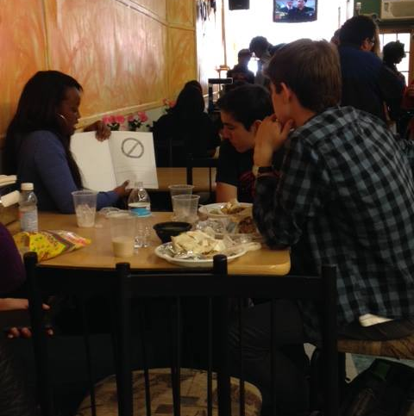
Examples from some of our colleagues
MYP & DP Language acquisition - Spanish
You will go to a neighborhood restaurant and speak only Spanish while ordering your meal. While eating level 4 students will give level 1 students feedback on their story book summatives.
P

Slide 14
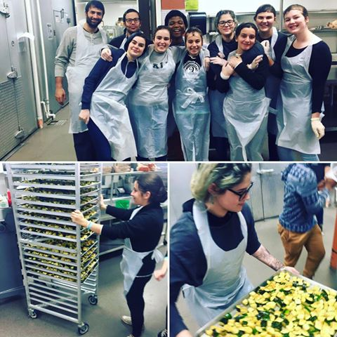
Examples from some of our colleagues
The Collegian Staff
P

Slide 15
We have an assignment for you
GRASPS by Wiggins and McTighe - Can provide focus and check for authenticity.
Goal, Role, Audience, Situation, Product, Standards
Think of an authentic learning experience that is relevant to your students that either you or teachers at your school could explore.
Write down your idea.
P

Slide 16
We have an assignment for you
Turn to a neighbor and give a brief overview of your idea.
Hold on to your idea! You may wish to further refine it, entirely change it or keep it as is
P

Slide 17
Implementing the project
MYP Digital Design Year 5 - First and only year of Design for our students.
A project-based unit that took place over 8 weeks (1 term) - Two previous terms spent learning design cycle, objectives, and aims through smaller more guided projects.
Followed the design cycle: inquiring and analysing; developing ideas; creating a solution; evaluating the solution.
Formative tasks allowed students opportunities to develop factual, procedural, and conceptual knowledge required to successfully undertake project.
J

Slide 18
Outcomes of the project
Student engagement was exceptionally high: Several students chose their own or surrounding neighborhoods, which made the experience quite personal. Some student focused areas affected by recent riots.
Built and strengthened relationships with representatives and members of community; Delegates, Mayoral candidates, Senatorial candidates, city planners etc.
Head of school attended students’ presentation demonstrating support.
Some students presented before all faculty to demonstrate an example of authentic learning task. This could inspire other teachers to be proactive in creating these tasks.
J

Slide 19
Challenges of the project
Originality - most students chose to build Recreation Centers
Over 100 individuals invited; 30 RSVP including mayor and governor - 6 attended
Local media outlets were contacted with press briefing - One online periodical ran story
J

Slide 20
Return to your assignment
What are the next steps required to implement this authentic project?
What potential community partnerships could be formed?
How might you encourage others to develop authentic projects in their subject-groups? What interdisciplinary learning could take place?
P

Slide 21
Works cited
From principles into Practice. IBO 2014
Herrington, A.J & Herrington, J.A. (2007). What is an authentic learning environment?. In L.A. Tomei (Eds.), Online and distance learning: Concepts, methodologies, and applications (pp.68-77). Hershey, PA: Information Science Reference.
Newmann, F.M., et al. (1995). Authentic Pedagogy and Student Performance. Center on Organization and Restructuring of Schools. Madison, WI.
Wiggins, G and McTighe, J. 1998. Understanding by Design. Association for Supervision and Curriculum Development.

Slide 22
Thank you for attending!
Feel free to reach out to us if you have any questions or wish to continue the discussion.
P

