Slide 1
Opening Tweetchat (#DFIBforAll)
What are some challenges you face in terms of promoting student access to IB?
What does your school do to promote student access to the DP?
(Conference #IBTO2016)
@johnfalino1
@careim2
@meghalberg
@erinvred

Slide 2
IB For All: Promoting Equity and Access in the Diploma Programme
Dr. John Falino (IB Head of School)
Marion Halberg (IB Coordinator)
Candace Reim (IB Administrator)
Erin Vredenburgh (Director--Special Education)

Slide 3
IB For ALL:
Promoting Equity and Access in the DP
How did Dobbs Ferry High School transition from an elite model to a Diploma Programme that is accessible and equitable for all students?

Slide 4
Session Takeaways
How to build community support and understanding
How to build K-12 faculty and staff involvement
The role of school leadership
Designing a school structure that supports IB

Slide 5
We encourage all participants to
“backchannel” during this workshop at
#DFIBforAll
(Conference #IBTO2016)
@johnfalino1
@careim2
@meghalberg
@erinvred

Slide 6
Opening Tweetchat (#DFIBforAll)
What are some challenges you face in terms of promoting student access to IB?
What does your school do to promote student access to the DP?

Slide 7
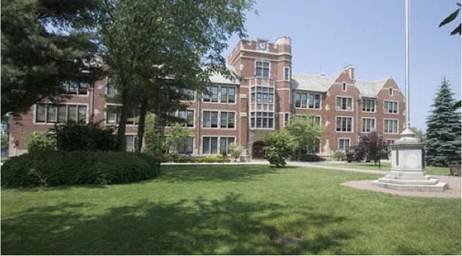
Dobbs Ferry High School Profile

Slide 8
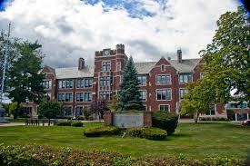
The Village of Dobbs Ferry
Location: Westchester County; 15 miles north of New York City
A Hudson “River Town”
Town is 3 square miles with approximately 10,000 people
Diverse community
Rich in History

Slide 9
Dobbs Ferry High School
IB World School since 1998. First in Westchester County.
Approximately 440 students at DFHS
100% graduation rate
85% go on to four year colleges
Special Education population 13%
ELL population/Non-English speakers
Notes:
Report on languages in the home from eschool

Slide 10
The IB DP Program at DFHS
Approximately 25% of students attempt the IB Diploma each year
Students registered for 451 subject entries in 2016
All students take a minimum of 2 IB DP courses
On average students take more than 3 courses
Student performance is consistent with the world average

Slide 11
Our IB Journey
In 1998, DFHS was authorized as an IB school. BOE and community believed in the vision and mission of the IB
Started as an “elite” program (“school within a school”)
Community perception pre 2011
Community perception post 2011
Expansion of the IB DP programme to include all 11th and 12th graders
Implementation of the MYP program grades 6 - 10

Slide 12
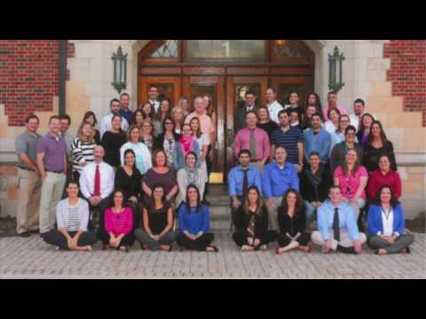
A Look Inside Dobbs Ferry High School

Slide 13
Dobbs Ferry High School
Students who have arrived in US within the last three years have come from
Guatemala, Egypt, Japan, Nigeria, South Korea
Home languages self-reported in school database
Spanish, Korean, Japanese, Ukrainian, Serbo-Croatian, Farsi, Chinese, Bulgarian, Malayalam, Tagalog, French, Greek, Urdu, Swedish, Arabic, Albanian, Russian
Notes:
Home languages from eschool: Spanish is most predominant; home languages are under-reported due to changes in way data is entered since students may have first registered in district. Our Salutatorian was in the ESL/ELL program in elmentary school as were other diploma candidates. Several do not speak English at home.

Slide 14
Free & Reduced Lunch Participation
Session | Number of Students | Number of subject entries
May 2013 | 4 | 6
May 2014 | 6 | 13
May 2015 | 11 | 19
May 2016 | 17 | 39
Notes:
High schoolers under report free lunch status

Slide 15
Promoting Access in Special Education
Co-taught classes
IB English SL
IB Math (3 levels)
Special Education teachers trained in IB
Group 6 & TOK
Spanish Ab Initio

Slide 16
The 1:1 Chromebook Program at DFHS: Leveling the Playing Field
In-line with the district philosophy of differentiation and meeting the needs of ALL students
“The goal of IB is to increase access and engagement while removing barriers to learning.” -IB Guide to Inclusive Education

Slide 17
How did we do it?

Slide 18
Why IB? The 2011-2012 School Year
Competing community views: AP vs. IB
Questions around
philosophy
college credit
college admissions
pedagogical and curricular approach
Limited offerings in IB Math, IB English, IB Language
Class of 2012 students registered for 366 subject entries 12 full IB Diploma Candidates
Community was at a crossroad with IB
Notes:
Instead of exams, subject entries; subject entries for 2012=366

Slide 19
DFHS IB Journey
Gaining Community Support
Leadership
New Superintendent, Assistant Superintendent, and High School Principal
New vision around 21st century learning
Informal book chats (The Global Achievement Gap)
IB Community Forums
District strategic planning
Branding the IB Program
Superintendent’s and Principal’s blogs
Community Consensus: IB allows for a unifying vision that we all value and believe in.
Notes:
Embracing the IB learner Profile! This was key for faculty and student buy-in!!!

Slide 20
DFHS IB Journey
Increasing Faculty Understanding, Capacity and Support
Faculty was always in support of IB but not fully invested 9-12
Embracing the IB Learner Profile school-wide (Commended on Five-Year Self Study Evaluation)
All teachers and guidance counselors trained IB DP
9th and 10th grade curriculum design (“pre IB”)
Restructuring of the teacher leader positions
Targeted professional development (TOK, 1:1 technology)
Moving teachers around

Slide 21
Changes to the IB Instructional Program
Expanding offerings in Math (grades 9-12)
IB English SL
IB Spanish Ab Initio
IB Film
TOK for all
Science Research
Embracing the IB Learner Profile 9-12

Slide 22
Transition to the IB MYP
Began formal transition in the 2014-2015 school year
DFHS working from a place of strength
Easy buy-in. Aligned with mission to increase student participation and performance
Alignment with science research
Personal Project

Slide 23
The IB at DFHS Today
Explore more course offerings
Investigate online coursework
Goal of 100% faculty IB trained
Continue to build understanding and support throughout community for IB
New Initiative: Recognize faculty and staff for emulating the IB Learner Profile

