Slide 2
Under Fire: University Recognition Update
July 15, 2016
Civic South
3:45pm-5:00pm

Slide 3
Session Presenters
Andrew Arida, University of British Columbia, Associate Registrar, Undergraduate Admissions
Debra von Bargen, Stanford University, Assistant Dean of Admission
Shannon Gundy, Director of Undergraduate Admissions, University of Maryland- College Park
Marie Vivas, University Relations Manager, The International Baccalaureate

Slide 4
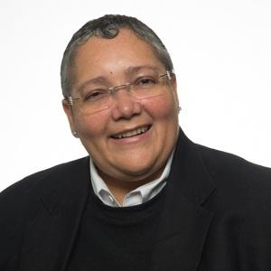
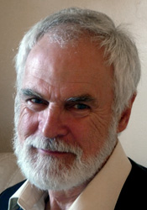
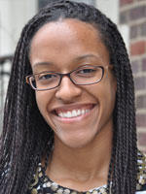
University Relations Team - IBA
Marie Vivas
All US and Canadian Universities, Ecuador Project, Associations URM, CURC, outreach and assistance to secondary school counselors and IB Coordinators and to other regional universities as needed
Bob Poole
Government liaison for all US States and Canadian Provinces – works closely with Associations and is in charge of data delivery to states and provinces
Rachelle Bernadel
Administrator – Works with university stakeholders on issues related to transcripts, policies and IBIS related concerns – manages blog, GNL and social media - prepares and updates materials and presentations, staffs conference booths.

Slide 5
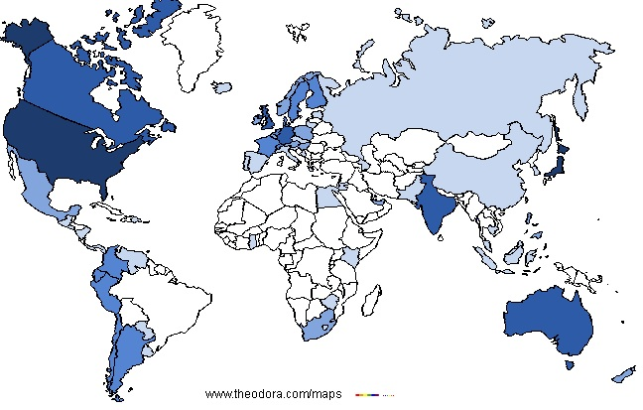
Global University Recognition
Number of universities with published recognition policies in the IB Information System
1-5 Universities | 6-10 Universities | 11-20 Universities | 26-250 Universities | 251+ Universities

Slide 6
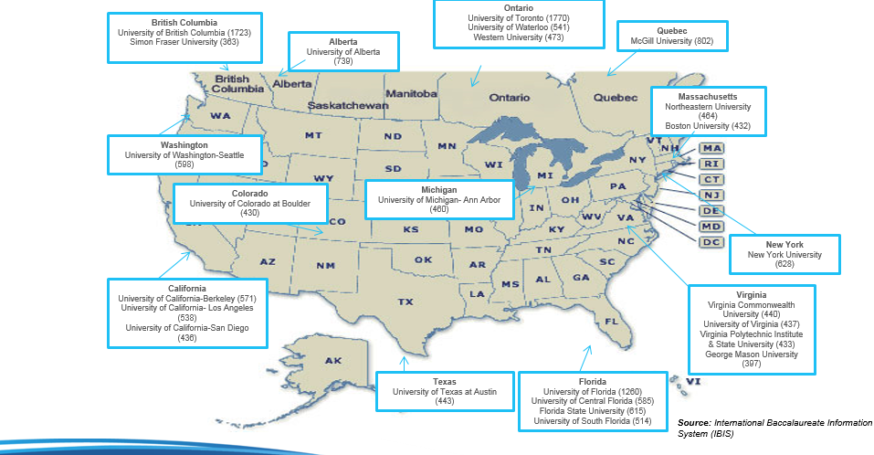
Top 25 IB Transcript Receiving Universities in North America
Notes:
These are schools that many IB students send their transcripts to. It is important to note that there are many selective colleges on this list that are not ivies, that may be a good match for IB students. The goal is to have options!

Slide 7
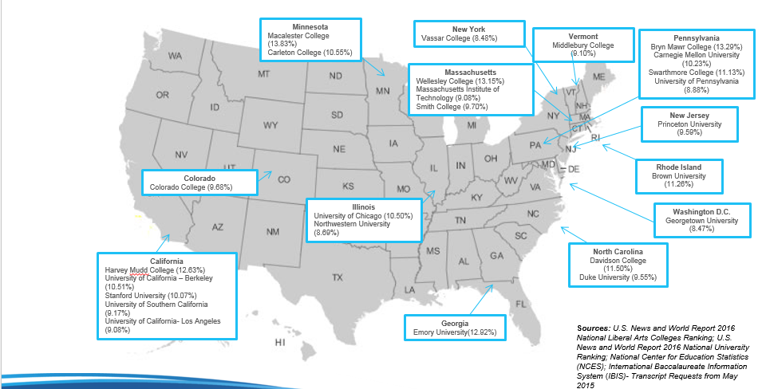
Percentage of Freshman IB Students enrolled in Top 25 Liberal Arts and Research Institutions in the US- Fall 2015
Notes:
These are schools that have a high percentage of Freshman's on campus. Again, it is important to note that there are many selective colleges on this list that are not ivies, that may be a good match for IB students. The goal is to have options!

Slide 8
Current IBA Initiatives
IB College Fairs
IB Student College Access Workshops
University Visits
Interactive Workshops
Video Training Sessions
IBCP Campaign
Professional Conference Presentations
College and University Relations Committee
Higher Education Summits on Access

Slide 9
Counselor Services
College Counseling Sessions at regional and national conferences
Counselor Breakfasts
Good News Letter (600+ recipients)
Counselor Communications
Facebook Group (1,091 members)
University Relations Blog (51 posts, 2,700+ hits, Where to find?: Good News Letter, Direct Link, IB Community Blog)

Slide 10
Resources
General Information
International Baccalaureate Organization public website: http://www.ibo.org/
Quick tutorial on the IB: http://ibo.org/en/digital-toolkit/country-specific-materials/
Resources and Documents: http://www.ibo.org/en/university-admission/ib-recognition-resources-and-document-library/
Diploma Impact Studies: http://www.ibo.org/en/about-the-ib/research/programme-impact-research/
University Admissions Blog: http://blogs.ibo.org/universityadmissions/
Facebook Group: IB Counselors, Coordinators and University Relations
Contacts
IB Answers: https://ibanswers.ibo.org/
Marie Vivas, IBA University Relations Manager
(301) 202-3178
Marie.Vivas@ibo.org
Rachelle Bernadel, IBA University Relations Administrator
(301) 202-3177
Rachelle.Bernadel@ibo.org

Slide 11
Global Recognition Update

Slide 12
Improve and develop services to stakeholders
Events
Higher Ed symposia
World Student Conferences
Higher Ed forums
The IB Student Registry
Legalization services
New collateral and resources
Research and analysis
Redeveloping PD workshops for counsellors

Slide 13
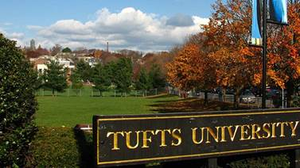
IB Higher Education Symposium
November 9-10, Tufts University, Boston, MA, USA
Brings together higher education admissions and IB World Schools to discuss issues, challenges and best practices in creating pathways for IB students.
Topics:
Effectively leveraging research
Diversity in the IB
Secondary/tertiary partnerships
Roles and responsibilities in creating student pathways
University fair
Notes:
Topics:
The rigorous preparation with which IB students enter your university and the holistic way in which they enrich your university’s idealism
A global perspective on college and career readiness – what can we learn from each other?
High-level discussion with top university leaders in the field on globalization, student mobility and promoting access
Analysis of the latest IB research presented by Educational Policy Improvement Center (EPIC) and the IB Head of Research
New services and tools from the IB that will support your ability to recruit a diverse and academically qualified cohort of internationally-minded students
University presidents symposium

Slide 14
IB World Student Conferences
Week-long university and service learning immersion conferences for DP, CP and MYP students
Registration: $950
Les Roches International School of Hotel Management, Bluche, Switzerland, 3-9 July, 2016
University of Denver, CO, USA, 18-24 July, 2016
www.ibo.orb/wsc

Slide 15
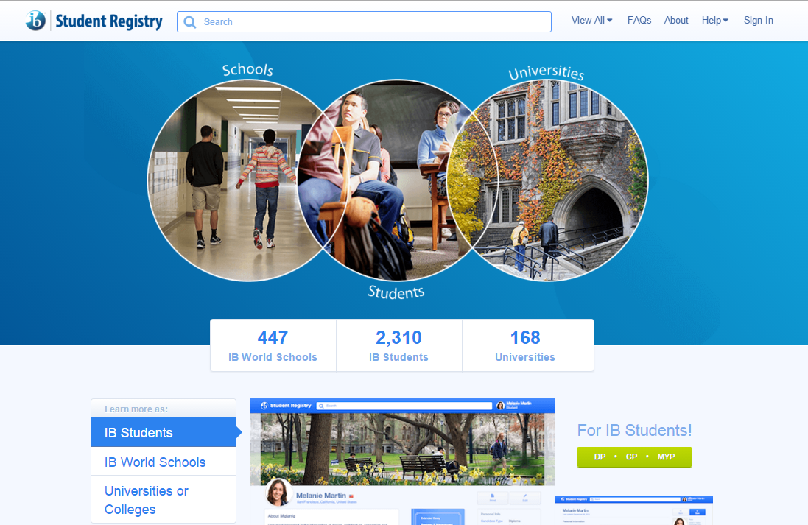
IB Student Registry
connects IB students with universities
provides information on universities’ IB recognition policies
showcases profiles of IB World Schools.

Slide 16
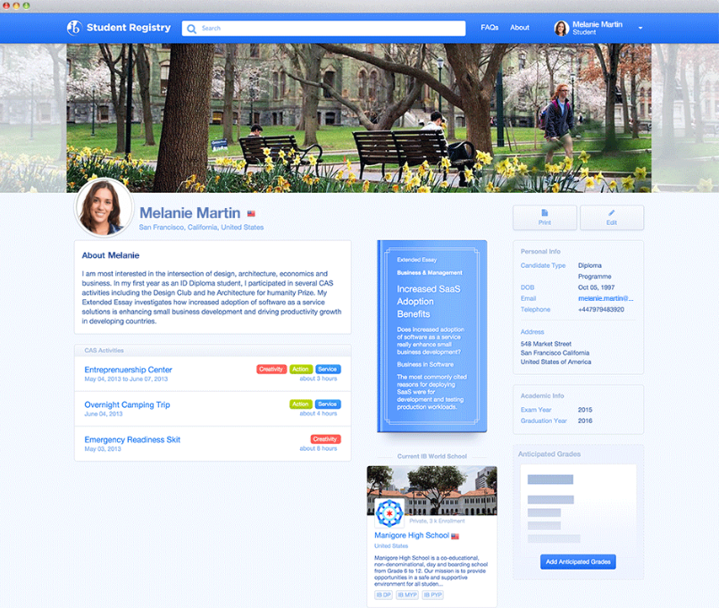
Students
MYP, CP, DP age 15-19 Personalized profile to highlight IB experience and accomplishments Access to database of universities interested in IB students Customizable search by filters
Notes:
Finding and gaining admission to a university of choice can be overwhelming. IB students want their secondary work to be recognized. IBSR helps them find universities who understand and favor IB.

Slide 17
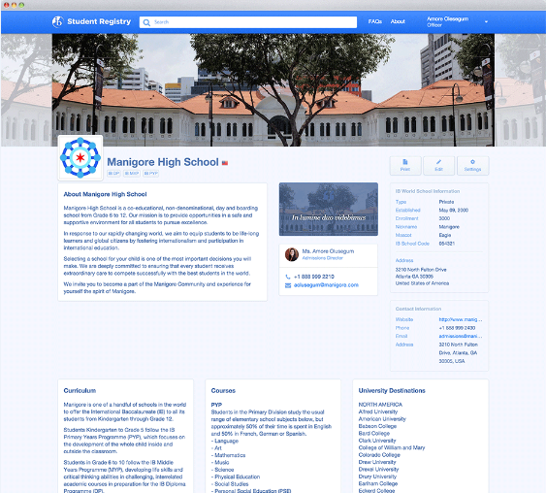
Schools
College counselor and/or programme coordinator Increased visibility to universities seeking to recruit IB students and planning recruitment visits Access to database of universities interested in IB students and their policies Free customizable profile to showcase academic life and extra-curricular activities

Slide 18
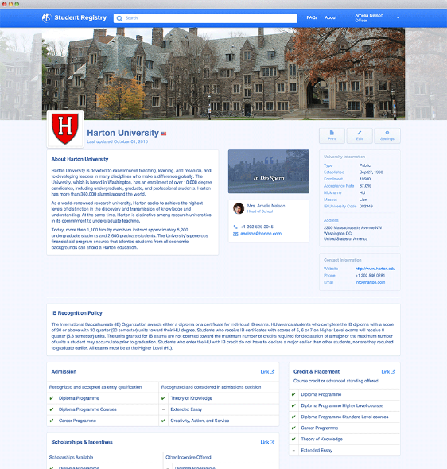
Universities
Admissions director or officer Access to database of candidates with strong academic performance and skills for success in the university environment. Access to database of schools to plan recruitment visits Customizable profile to showcase university and demonstrate interest in recruiting IB students,
Notes:
College readiness continues to be an issue. IB students have content knowledge, cognitive strategies, and academic behaviors that make them more likely to succeed in univ. than their non-IB peers. IBSR helps universities identify and recruit these students.

Slide 19
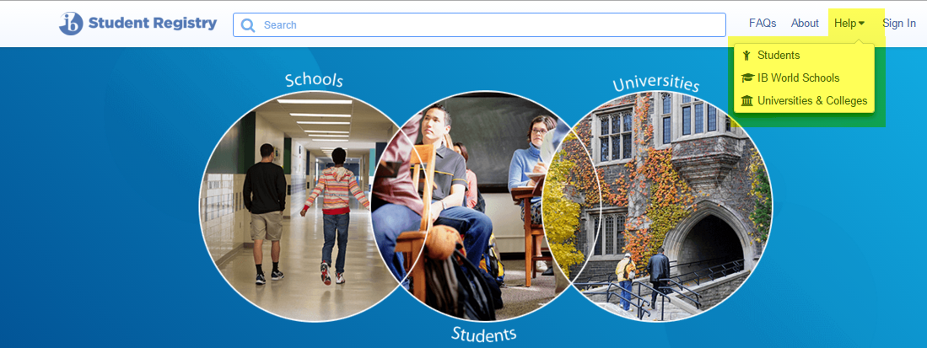
Support
Help documentation available on homepage
General email queries registry@ibo.org

Slide 20
Some Points to Consider
What is the true value of the IB Diploma?
How do we market the IB to students and parents? What are the implications of this approach?
How do IB students approach university courses?
How are recognition decisions made on university campuses?

Slide 21
Frequently Asked Questions by Secondary Schools
Why do universities not give credit for Standard Level courses?
Why is Advanced Placement seen as better than an IB Diploma?
Why don’t students receive recognition for Theory of Knowledge and the Extended Essay?
But what does it mean from an academic perspective when students skip large portions of an institution’s first year curriculum?
What happens to a student’s admission offers if they don’t meet their predictions?
How many HL courses do you want to see?

Slide 22
Frequently Asked Questions by Universities
Why are there significant discrepancies between anticipated and final grades?
Are there over-prediction/under-prediction trends among schools?
How are anticipated grades are derived?
How/Why do schools combine AP, IB and the “regular” high school curriculum?

Slide 23
Question and Answer Period
Marie Vivas will take questions from the audience and ask one or two of the panelists to answer so we can get through as many questions as possible.

