Slide 2
Diploma Programme curricular updates in sciences and mathematics
Oksana Jajecznyk
Head of curriculum development DP/CP
Notes:
CM for DP chemistry and NOS pilot. Acknowledge the BH connection.

Slide 3
Objectives of the presentation
Update on curriculum developments in the sciences and mathematics.
Update on sciences curriculum review.
Looking ahead to the curriculum review of biology, chemistry, physics and nature of science
Questions on sciences curriculum development

Slide 4
DP Science subjects
Biology
Chemistry
Design Technology
Physics
Sports, Exercise and Health Science (SL and HL)
Computer Science
Nature of Science (pilot course at SL)
Environmental Systems and Societies (SL only)

Slide 5
Biology, Chemistry, Physics
Biology, chemistry and physics assessed for the first time in May 2016
Updates to TSM underway
Curriculum development team coming to the end of year 2 of research phase, the first stage in developing curriculum for first teaching in 2021.
Notes:
TSM updates are in progress. Subject reportsTSM updates are in progress. Subject reports.
Evaluation TSM updates are in progress. Subject reports.
Evaluation (reports from external conusltants, examiners, survey data, alumi teachers etc, literature reivew, syllabus comparisons and feedback from universities.
Development – meetings with teachers, examiners, consultants from all 3 regions. Feedback from teacher surveys, from review committess and trialling of new assessment tasks and criteria.
Implenetation – production of new materials, upskiling of WSL, SSS and accredication and recognition.

Slide 6
Teacher feedback on biology, chemistry and physics DP courses
Surveys currently open on the OCC:
Internal assessment (closes end of Sept 2016)
Subject content (closes end of Sept 2016)
Teachers across the programmes have been invited to apply to be part of the curriculum review team.
Notes:
Good feedback coming in from surveys

Slide 7
Nature of science pilot course - first teaching September 2015
Overview:
What is science and what is the scientific endeavour?
The understanding of science
The objectivity of science
The human face of science
Scientific literacy and the public understanding of science
Notes:
The course is being designed for students, who may not study science after high school. It will provide a general education in science that will allow them to understand and make judgements on critical societal issues affecting their lives arising from developments in science and technology
NOS is a theme in the new science subjects, physics, chemistry and biology and the subject-specific programmes are delivered pedagogically through the integration of NOS in the subjects as a whole and in specific topics.
During the course students will be exposed to the Nature of Science and the implications that science has for society and how these affect their place in the world
Excellent foundation of ideas that can form a common conversation with AoK sciences and even with IB philosophy option.
ideas of the Nature of Science are constructed by the observations of how scientists work as a cultural group, studied as a sociological study, and this has moved our understanding of science significantly from that of the logical positivists along the road to the social constructivists, and this knits well with the contemporary notions of classroom pedagogy where young minds are learning in a social situation through the construction of ideas that are negotiated and agreed on in a social context.
It is this marked contrast between these ideas observed from outside the scientific community, and the views of practising scientists themselves that make the Nature of Science such an exciting field to be in, as it poses so many questions that scientists have no answer to, and often haven’t stopped to consider.
As here, the current presentation of science by scientists in science courses, however, is still very much on logical positivistic paradigm.
Consequently, a Nature of Science course should be a welcome opportunity to redress this balance through a playful exploration of the culture of scientific exploration, but explored through the critical eyes of a range of stakeholders, among them scientists, but also through the eyes of historians, the arts and literature, ethicists and philosophers, as well as scientists both past and present.

Slide 8
Current developments in NOS
This course was developed during the curriculum review of the present science courses.
First examinations in May 2017.
22 schools across all 3 regions.
Discussion and sharing of resources by teachers on a virtual forum.
First survey by pilot teachers completed and currently analysed.
Notes:
Will last 4 years. The pilot will be in English only. Planned webinars with teachers

Slide 9
SEHS
The new guide was published on the OCC in January 2016
Higher level will be available for first teaching in September 2016
The IA will be changed for both SL and HL for first assessment in 2018 to bring it in line with biology, chemistry and physics.
Additional HL topics and new material for the existing options
Teacher support material and HL specimen papers were published in June 2016.
French and Spanish versions of the specimen papers will be published soon.
Notes:
Large growth in this subject. Many thanks for this.
As is the practice will all new courses, workshops taking place from the February onward will focus on the new guide, and in the case of the SEHS course, emphasise the new IA criteria. For new schools that have introduced SEHS for first assessment in 2017 they will need to rely on the exemplars on the TSM (for use from 2009) as attendance at workshops will focus on the IA for assessment in 2018.
For those schools who were heavily moderated in M16 I’m not sure what can be done other than providing some very clear feedback as to the key areas of concern and to refer to the TSM for help with M17. I’m not sure what else can be done unless we are able to work with individual schools which I unlikely to happen.
I don’t believe this is a result of making curriculum changes at unusual times. The same must have happened in 2014 with the launch of the new biology, chemistry and physics courses. Any new school who had first assessment in 2015 would possibly have missed training for the old IA. Distinction between SL and HL
Group 4 students at standard level (SL) and higher level (HL) undertake a common core syllabus, a common internal assessment (IA) scheme and have some overlapping elements in the options studied. They are presented with a syllabus that encourages the development of certain skills, attributes and attitudes, as described in the “Assessment objectives” section of this guide.
While the skills and activities of group 4 science subjects are common to students at both SL and HL, students at HL are required to study additional higher level (AHL) material as well as HL topics within the options. The distinction between SL and HL is one of breadth and depth.

Slide 10
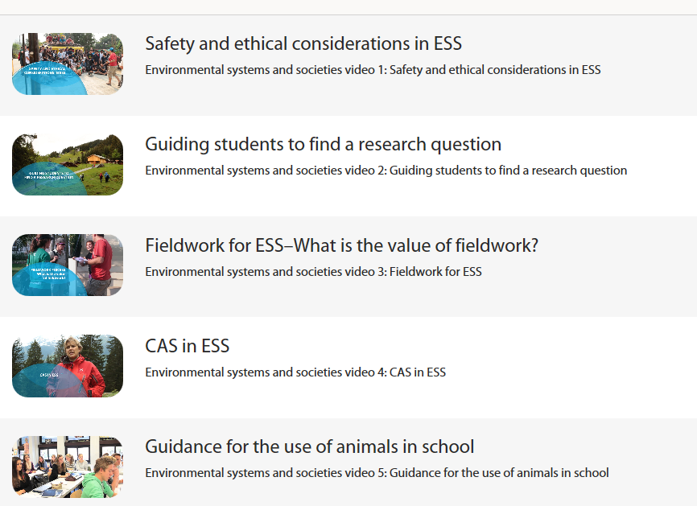
Environmental Systems and Societies (SL only)
First assessment 2017
Now in its research phase
ESS website – 5 videos to support teaching of the course.

Slide 11
Cross-programme review for biology, chemistry, physics and nature of science (pilot).
‘Super ERC’ (External Review Committee)- PYP, MYP, DP (CP) in October 2016.
IB staff, science teachers across the programmes, science education experts and a group of current IB DP students.
Build consensus on opportunities for development with respect for science education including feedback from the research reports for each science.
Promote appreciative inquiry into the characteristics of best in-class curriculum and assessment design for elementary and secondary science.
Parallel MYP and DP development meetings starting 2017
Notes:
Identification of major themes/issues in science education across the IB programmes
Propose leading external advisors who can address the issues
Opportunities for thought leadership in the field of science education.
Basecamps set up for teacher participants who have applied after the call out from the DP and MYP coordinators notes.

Slide 12
A few areas which will be discussed
Cross-disciplinary approach to solving complex problems.
Lab skills
21st century research skills
Systems thinking
Concept based learning
Innovation – how we build capacity
Notes:
Practices (skills) – students engage and directly experience the major practices which scientists employ as they investigate and build models/theories about the world around them and those which engineers use in designing and building systems. Practices is used over skills which implies greater engagement in scientific investigations i.e. It includes both SKILLS and KNOWLEDGE.
Cross cutting concepts – apply to all science domains drawing ideas and practices that cut across all disciplines. CCC can help students understand core ideas and practices in science and engineering, familiarisation of vocabulary for science and engineering and would include NOS and engineering concepts.
Patterns
Cause and effect: mechanism and explanation
Scale, proportion and quantity
Systems and system models
Energy and matter
Structure and function
Stability and change
Disciplinary core ideas – with the growth in scientific knowledge, how can it all be taught? Students need a sufficient core knowledge which would then allow them to acquire additional information on their own.
e is a definition from Peter Senge's highly influential The Fifth Discipline Fieldbook:
Systems thinking [is] a way of thinking about, and a language for describing and understanding, the forces and interrelationships that shape the behavior of systems. This discipline helps us to see how to change systems more effectively, and to act more in tune with the natural processes of the natural and economic world.

Slide 13
Design technology
Curriculum review launches in Sept 2017
Surveys are now open:
Internal assessment (closes Sept 2016)
Subject content (opens Sept, closes Oct)
Nature of design (opens Oct, closes Nov)
Notes:
The review of Design technology will be ‘paused’ for one year for further research.
This pause will mean that the new course will be for first teaching 2022.
This will allow Design technology to be reviewed in parallel with MYP design.

Slide 14
Design technology
Invitation to be part of curriculum review now released
Basecamp discussion group
Email Dpdevelopment@ibo.org with ‘DT Basecamp discussion group’ in the subject title
Face-to-face curriculum review
Apply by sending CV and brief description of what you would change to Dpdevelopment@ibo.org with ‘DT curriculum review’ in the subject title

Slide 15
Computer science
Curriculum review paused until March 2017
ERC report available on the OCC homepage
Computer science to be grounded in “Nature of Computing” and Computational thinking
Notes:
The External review committee meeting was held between 16 and 18 January in The Hague. This was a joint meeting with representative examiners and teachers from Computer science and ITGS present.
The group were tasked with developing the nature of the subject: one for ITGS and one for Computers science. The team was split into two parts at this point. The nature of the subject would be a foundational document for the course in a similar way that Nature of Science underpins the science courses.
The Computer science team determined that they should develop the Nature of Computing as the appropriate foundational document.
The ITGS team propose the Nature of Social informatics. They also propose a refocus of the subject as a Group 3 Social informatics course.
In developing the two foundational documents, the teams addressed the subject –specific questions that came out of the Internal Review Committee meeting, as detailed in the report. These questions are included in the introduction as a reminder. The questions that have not been directly addressed in this report were used as points for consideration through the three day meeting, and discussed on Day one in order to inform the development of the Nature of “subject” documents. This is addressed indirectly through the discussion held to develop the Big ideas in Computer science and IT education.
Further detail of the Nature of Computing and the Nature of Social informatics can be found in the body of this report.
There are several required actions following on from the meeting, which are facilitated by delaying the review of Computer science and ITGS/Social informatics for one ye

Slide 16
Computer science
Computer Science - grounded in computational thinking and programming.
Information Technology - the study, design, development, implementation, support or maintenance of computer-based information systems, for people/machines to organize, process, share, and/or store information in various forms.
Technology Literacy (in a computational context) the ability to combine, adapt to and develop new technologies as needed.
Three dimensions of computing

Slide 17
Computer science
"Computational Thinking is the thought processes involved in formulating problems and their solutions so that the solutions are represented in a form that can be effectively carried out by an information-processing agent."
Cuny, Snyder, Wing
Computational thinking addresses aspects of:
a) decomposition and (re-composition) synthesis
b) pattern recognition and pattern generalization
c) abstract thinking
d) algorithm design
Computational Thinking includes algorithmic thinking, recursive thinking, logical thinking, procedural thinking, and digital design thinking.

Slide 18
Computer science timeline
Teaching year | Curriculum review activity | Timescale
T3 – Evaluation and development | ERC meeting and IRC meeting 2 | 2015/16
T3 – Extended development phase | IRC meeting 3 and 1st CR meeting | 2016/17
T4 – development | 2nd and 3rd CR meeting | 2017/18
T5 – development | Assessment trial 4th and 5th CR meeting | 2018/19
T6 – Development | 6th CR meeting (TSM) Guide completed | 2019/20
T7 – Development and publication | Guide published SSS workshops | 2020/21
T1 – Implementation | 1st teaching | 2021/22
T2 - Evaluation | 1st exams | 2022/23

Slide 19
Computer science
Invitation to be part of curriculum review now released
Basecamp discussion group
Email Dpdevelopment@ibo.org with ‘CS Basecamp discussion group’ in the subject title
Face-to-face curriculum review
Apply by sending CV and brief description of what you would change to Dpdevelopment@ibo.org with ‘CS curriculum review’ in the subject title

Slide 20
Information technology in a global society
The review of ITGS will be ‘paused’ for one year for further research
The revised course will be for first teaching 2021

Slide 21
Mathematics Curriculum Review
Curriculum review meetings have taken place in 2015 and 2016 and will continue throughout 2017 to look at the provision of mathematics within the DP.
Two new courses will be available for first teaching in 2019 (first assessment 2021)
One course will be more applications and technology based than the other. Both courses will cover the overarching concepts of number and algebra, functions, geometry and trigonometry, statistics and calculus
Each course will be available at SL and HL with SL being a complete subset of the HL; similar to other subjects within the DP
There will be a number of hours allocated to common material across both SL courses

Slide 22
Mathematics Curriculum Model
Mathematics HL
90 hours
Mathematics with Applications HL
90 hours
Mathematics SL
60 hours
Mathematics with Applications SL
60 hours
Core SL
60 hours
Internal assessment
ATL skills / mathematics toolkit
30 hours
Notes:
Agreed – 20 hours core HL no
Prior learning and SL core

Slide 23
R1 – Patterns, systems and relationships
R2 – Patterns, relationships, truth and certainty
R1 – Transformations and representations
R2 – Creating and manipulating models
R1 – Rate and accumulation
R2 – Rate and change
Mathematics
R1 – Shape, proportion and space
R2 – Geometry – describing shape and space
R1 – Randomness, prediction - truth and certainty
R2 – Analysis and prediction
Notes:
Hand out
– titles or different same or different? – complicates or over simplifies?
5 domains – hours do not have to be the same

Slide 24
Mathematics Curriculum Review
30 hours will be allocated to developing mathematics skills, including collaboration, modelling, inquiry skills and for the IA.
The new IA will be based on the current Exploration model with some modifications to the assessment criteria and guidance .
This is being trialled in August and September, with 18 teachers each marking 42 explorations/projects to test the appropriateness, ease of interpretation and fairness of the new criteria
Reports of previous meetings are available on the OCC.
A mid-review teacher survey will be sent to schools in September 2016
Notes:
Trials are underway.
This survey is focused on the curriculum review proposals; first teaching in 2019 and first assessment in 2021. When answering the questions below, please refer to the reports on the curriculum review which are available on the OCC under the “Curriculum review” section. There will be space given for open responses at the end of each section.

Slide 25
Thank you very much for attending this session.
Enjoy the conference and have a wonderful summer!
Please share your questions and feedback with us at
dpdevelopment@ibo.org
Notes:
Share course summaries on basecamp

