Slide 2
Getting Beyond Credit to Success – Translating the Value of IB for low-income and underrepresented minority students
July 16, 2016
Chestnut West
2:00pm-3:15pm

Slide 3
Rachelle Bernadel, International Baccalaureate, University Relations Administrator, rachelle.bernadel@ibo.org Kevin Hudson, Princeton University, Assistant Director for College Opportunity – Office of the Provost, kchudson@Princeton.edu Brian Spittle, DePaul University, Assistant Vice President - Center for Access and Attainment, bspittle@depaul.edu Risa Langelo, University of Nebraska Lincoln, Assistant Director of Admissions, risa.langelo@unl.edu
Session Panelists

Slide 4
The State of IB for Title 1 IB Students

Slide 5
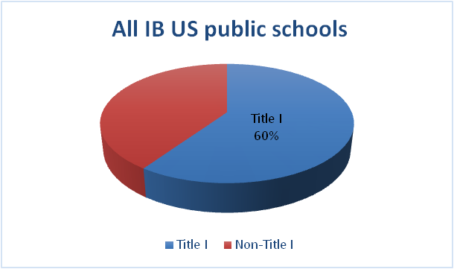
Access to IB programmes
60% of all public schools that offered IB programmes in the US (2012-2013) were designated Title I.
© International Baccalaureate Organization, 2015
Notes:
But more work still needs be done to encourage greater participation of low-income and minority students in IB programmes in these schools.

Slide 6
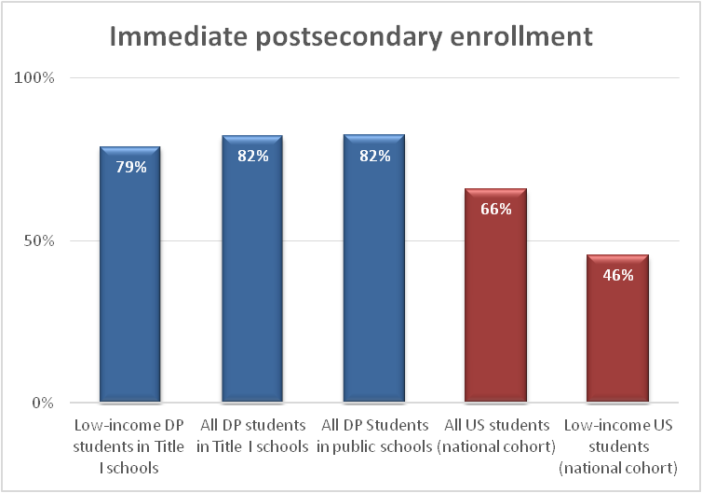
College enrollment outcomes
DP students from Title I schools enroll in college at much higher rates than the national averages.
© International Baccalaureate Organization, 2015
Notes:
Low-income DP students from Title I schools also enroll at very high rates (79%).
This rate is substantially higher than the national average for low-income students (46%).
DP students from Title I schools enroll in college at the same rate as DP students from US public schools generally (82%).

Slide 7
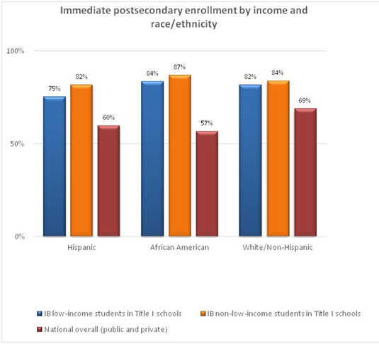
College enrollment outcomes
Low-income African American DP students from Title I schools have the highest college enrollment rate among the racial/ethnic groups in this study (84%), while nationally the college enrollment rate of African American students is the lowest (57%).
Notes:
African American DP students from Title I schools have the highest postsecondary enrollment rate among the racial and ethnic groups represented in this study (84%), while nationally the college enrollment rate of African American students is the lowest (57%).

Slide 8
Key points
IB programmes have a substantial presence in Title I schools.
Race/ethnicity and income of an IB student has limited effects on his or her college enrollment.
African American DP students from Title I schools have the highest postsecondary enrollment rate among the racial and ethnic groups in this study.
© International Baccalaureate Organization, 2015

Slide 9
Institutional Perspectives

Slide 10
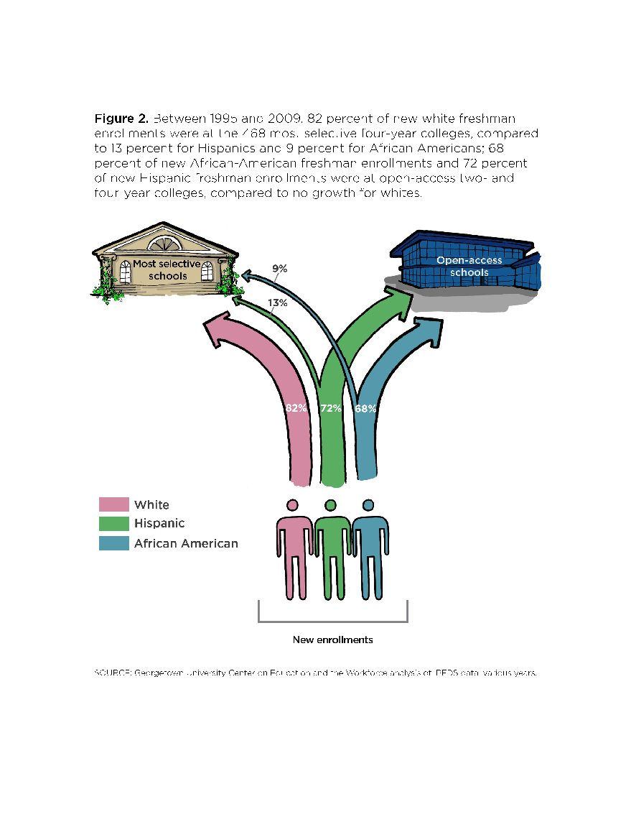
There are two separate postsecondary pathways.
The vast majority of white freshmen are going to the 468 most selective four-year colleges.
African American and Hispanic freshmen on the other hand are primarily attending under-resourced two- and four-year colleges.
SOURCE: Georgetown University Center on Education and the Workforce
analysis of IPEDS data; various years.

Slide 11
Source: NY Times, Who Gets to Graduate
.

Slide 12
IB APPLICATION TO SELECTIVE AMERICAN UNIVERSITIES
Is student academically prepared?
HS Transcript
Profile (context)
External Academic
PSAT/SAT/ACT/SAT Subject Scores/ IB Predicted Scores
Will student contribute to life of the college/university?
Evidence of Contribution to School or Home Community (Including Family)?
Meta Cognitive Variables
(Social Capital)
Motivation
Perseverance
Goal Setting
Navigating System
Recommendations

Slide 14
We gather you here, physically and in person, because community and relationships matter fundamentally to our mission. People often conceive of education as though it were a purely intellectual or utilitarian activity involving nothing more than the transmission of information from one brain to another. That is not how we see it. We believe that learning also requires qualities of character and feeling and judgment: motivation, engagement, initiative, persistence, resilience, curiosity, imagination, and daring. These are aspects not of information or argument but of people, and they are inspired and nurtured by the kinds of relationships that develop on campuses like this one.
- Christopher L. Eisgruber, President, Princeton University, Opening Exercises, 9/13/2015
In an aside, Brooks characterizes universities of preparing students for resume virtues. And it’s true. We do. Unabashedly, and without apology. We exist to introduce students to the intellectual life, to show them the world and to prepare them to be actors in it. It’s our purpose.
And rather than accept the dichotomy, DePaul entwines it with something larger. Something contained within our very motto: Viam Sapientiae Monstrabo Tibi, (“I will Show You the Way to Wisdom”). We seek to prepare not only educated human beings, but wise ones. Graduates with perspective, able to choose and pursue what’s most valuable in the world, intent on directing their life’s energies to make a difference for the world.
- Rev. Dennis H. Holtschneider., C.M., President, DePaul University, 18th Annual Academic Convocation Ceremony, 9/3/2015

Slide 15
SAMPLE DISTRIBUTION REQUIREMENTS

Slide 16
Expanding Access and Success
Princeton University College Opportunity & Success Initiative
COLLEGE ACCESS | Princeton University Preparatory Program (PUPP) Leadership Enterprise for a Diverse America (LEDA) Princeton Summer Journalism Program MATRICULATE Admission Office Outreach
COLLEGE SUCCESS (In College) | Freshman Scholars Institute Scholars Institute Fellows Program
Graduate School & Career Achievement (Post-College) | PSURE Junior Summer Institute (JSI) PhD Prep Program
Notes:
College Access – Pre-College / College Success – In College / Graduate School & Career Achievement – Post-College

Slide 17
Life After College
“The new measure of a sufficiently prepared student is one who has knowledge and skills to keep learning beyond secondary school, first in formal settings and then in the workplace throughout their careers, so that they are capable of adapting to unpredictable changes and new economic conditions and opportunities.”
- David Conley, Getting Ready for College Careers, and the Common Core (2013)

Slide 18
HIGHER EDUCATION MATTERS

Slide 19
DePaul University: mission-based commitment to student access
Largest Catholic university in U.S.
24% of freshmen are students of color from underrepresented groups
33% are from first-generation college families and 34% are Pell-eligible
Enrolls more graduates from Chicago Public Schools than any other private selective university

Slide 20
Why IB is important to DePaul
Models a mission-based enrollment strategy in Chicago. Provides a compelling access story for internal and external audiences.
Builds visibility for DePaul at the intersection of CPS strategy, UChicago Consortium research and the repositioning of IB globally from ‘a program for the elite to an elite program for everyone.’
Challenges prevailing mental models by defining postsecondary access and outcome in attainment - and even transformational - rather than remedial terms.
Chicago has the highest concentration of IB programs of any city in the world.

Slide 21
Timeline of IB expansion in Chicago Public Schools
Lincoln Park High School one of the first four IB programs in the US

Slide 22
Working to My Potential (2012)
IB students from CPS schools….
40% more likely to attend a four-year college and 50 percent more likely to attend a selective college
Significantly more likely to persist in college for two years.
Feel prepared to succeed in college and indeed do excel in their coursework.
Have limited access to the social capital necessary to successfully navigate college course selection and establish relationships with faculty

Slide 23
Responding to student and parent questions about IB in Chicago
Why should I choose IB if I get into a ‘selective enrollment’ school?
My friends aren’t working as hard as I am and yet they are getting better grades.
My grades got worse after I started IB. Will that hurt my chances of admission?
Why should I bother with the IB exams?
What if I don’t get the Diploma? Have I failed?
UChicago Consortium data on IB student success.
NACAC State of Admission survey – ‘strength of curriculum’ more important than standardized test scores.
High admit rate for IB applicants from CPS.
High graduation rates for CPS IB students at DePaul.
85% of CPS IB students entering DePaul get credit for at least one course.
DePaul stresses importance of Diploma program completion.

Slide 24
Communicating the value of IB to students in Chicago Public Schools
What we are learning about the value of IB for CPS students at DePaul
College credit is not the focus
The value of IB to CPS students is communicated primarily in terms of its academic quality and distinctiveness.
The possibility of college credit is downplayed in CPS communications.
For many IB students in CPS, interest in credit policies only begins to intensify after they have selected a college.
UChicago Consortium findings about the strength of academic preparation and college mindsets seem to be verified.
CPS IB students value credit in terms of affordability, timely progress to degree and expansion of academic options.
Students express value of IB primarily in terms of academic preparation and “family” of support.

Slide 25
When it comes to college, CPS IB students are both like and unlike other students from low-income and 1st generation families
Felt they were largely on their own in navigating the college admission, financial aid and enrollment processes & remain somewhat detached from college advisors given their poor experience in high school.
Yet report high levels of academic confidence and familiarity with the kinds of skills and discipline needed for college-level work.
They also have strong peer networks and are adept at navigating campus opportunities and resources.
At DePaul IB students are well represented in campus TRIO programs and have been quick to take advantage of first and second year ‘pathway’ programs designed to introduce low-income students to undergraduate research and graduate school.

Slide 26
CPS IB students matching access with attainment at DePaul
Freshmen profile
Graduation rates

Slide 27
Creating a pathway for high ability IB students from CPS at DePaul Center for Access and Attainment Research Lab for first-year students
Enrollment and training
Research project/ internship
Independent Research
Fall
Winter
Spring
Application to Mitchem Fellowship

Slide 28
Building pathways to graduate school for CPS IB students at DePaul
McNair Scholars Year 1
SRP
McNair Scholars Year 2
IRE
CAA Research Lab
Arnold L. Mitchem Fellowship
Freshman Experience
Introduction to research skills and
independent research project
Sophomore Experience
Focus on high impact educational experiences including International Research experience (IRE)
SSS- Mitchem Graduate Preparatory Program
SSS- Mitchem Graduate Preparatory Program
Junior Experience
Senior Experience

Slide 29
Building awareness with admissions staff: some IB college ‘Potholes’
Deadlines – IB students are really busy and may not be focused on application and aid deadlines.
Counseling and support – many IB students in CPS are navigating the admission and financial aid processes on their own. College counselors generally do not know them as well as IB coordinators and teachers.
IB grades – traditional assumptions about grades and grade trends may not hold for IB students.
Standardized test scores – not a good indicator for IB in CPS
Scholarships and aid – IB students may be below the radar. Danger of consistency issues in IB schools.
Communication – critical to reach students directly but email has its limitations.

Slide 30
UNL’s Urban IB Partnership
Chicago Public Schools Pilot
Scholarship criteria
Campus visits
Application and enrollment impact
Expansion to other key markets
Support to students from a variety of demographics and areas
Emerging Leaders Course

Slide 31
Emerging Leaders Course
Zero-credit, weekly course
Targets underserved students
Each week spotlights various campus leaders
Explore diversity and leadership skills and resources
Support through academic coaching, financial aid counseling, and peer mentoring

Slide 32
IBCP as a Pathway for all Students

Slide 33
IB Perspective: Growing CP Recognition
CP University Recognition Event
Educating admissions staff
Showcasing CP schools and students
Brainstorming policy
IB Information System changes
Track CP transcript destinations

Slide 34
IB Perspective: Growing CP Recognition
New Study: The International Baccalaureate (IB) Career-related Programme (CP): Students’ experiences, postsecondary destinations and outcomes
Satisfaction with the CP
Skills gained from the CP
Higher education and future career pathways
CP postsecondary outcomes
Employer and admissions officer views

Slide 35
DePaul: Preparing for the Career-related program
Outreach to IB Career-related program schools to foster communication and understanding.
Develop in-service training on Career-related program for Admission staff.
Include of Career-related program students in all campus programs for IB students.
Facilitate partnership conversations with local IB schools.
Monitor admit rates for Diploma and Career-related program applicants.
Work with information systems to ‘capture’ and track Career-related program students.

Slide 36
UNL: Career- Related Program
UNL IB George Beadle Scholarship Expansion
Includes CP students
Process:
Significant research and proposals
Communication and information from IBO
Partnerships with CP secondary school programs

Slide 37
Rachelle Bernadel, International Baccalaureate, University Relations Administrator, rachelle.bernadel@ibo.org Kevin Hudson, Princeton University, Assistant Director for College Opportunity – Office of the Provost, kchudson@Princeton.edu Brian Spittle, DePaul University, Assistant Vice President - Center for Access and Attainment, bspittle@depaul.edu Risa Langelo, University of Nebraska Lincoln, Assistant Director of Admissions, risa.langelo@unl.edu
QUESTIONS?

Slide 38
Questions?

