Slide 2
Building the CP From the Ground Up
Alameda International Junior/Senior High School
Susie VanScoyk – Principal
Steve Houwen – IBCP Coordinator

Slide 3
Purpose:
To support the development of the IB Career-related Programme
In schools which have minimal CTE development
or currently lack CTE programs.

Slide 4
Alameda International Profile:
Denver Urban/Suburban Transitional Community
IB Continuum School
MYP/DP Authorization 2010
DP first cohort graduation – May 2012
CP first cohort graduation – May 2016
Demographics:
 | 2009-2010 | 2015-2016
Minority | 72.8% | 85.9%
Free/Reduced | 68.0% | 86.4%
ELL | 38.5% | 51.5%
On-Time Graduation | 70.6% | 92.9% (14-15)

Slide 5
Alameda Profile
Access for All
We recognize the benefits of an IB education for all students
We encourage all students to take an educational risk
We recognize the positive future benefits for all students who participate in IB studies
Service Learning
Building-Wide approach with a dedicated coordinator for MYP/DP/CP
SL coordinator works with CP coordinator and pathway leads in developing service learning as well as internship/job shadow opportunities
Whole School IB Philosophy

Slide 6
Why CP?
Once had CTE programs in both FACS and DECA, but interest and participation had waned
FACS was phased out after the 2009-2010 school year, DECA after the 11-12 school year
Became a PYP, MYP, DP Continuum School by 2010
Recognized the positive impact of IB, both MYP and DP Programmes, on the success of students
Wondered how we might provide a different option for more of our students

Slide 7
What to do?
Developed a survey for students regarding career choices
All 9-10 graders took the survey
Survey indicated that futures in health careers were the primary choices by a significant majority of our students.
Identified that health careers are a local and national career need area
Identify available resources
Adding to Diploma Program or Stand Alone?
Current Staff, instructional and support staff (CTE Certified?)
Identify areas of community support
Flexibility of schedule
Notes:
Community support – local colleges, JC’s, businesses, Key Club, Chamber of Commerce, Career based businesses, etc.

Slide 8
Turn and Talk
Turn to someone nearby – from your school or another, and discuss:
What resources/strengths do we have?

Slide 9
Developing Career-related Studies
Identify the pathway – as described: survey, resources, etc.
How can it be scheduled?
Sensible progression
Fit other non-CP core courses
Be prepared for changes/modifications
Courses
Scheduling
Staffing
Notes:
Scheduling – graduation requirements: Econ, Logical science progression for college bound: Bio and Chem specifically

Slide 10
Developing Career-related Studies
Identify Coordinator/Pathway Leaders
Engage Counseling
Engage District CTE and Curriculum & Instruction
Engage local College/University liaison
Establish fit with the CP requirements?
Connect with IB Americas Leadership
Identify support from existing CP/CTE programmes
Who does what you want to do?
Why did they choose those courses?
What are the differences/similarities between schools?

Slide 11
Developing Career-related Studies
What makes it successful at AIHS?
Staff
Flexibility in scheduling (think outside the box)
New courses
Cross year/semester scheduling
Where are there spaces? (Advisement)
Commitment to training ($)
Community Partnerships
Concurrency of Learning
Willing students

Slide 12
Developing Career-related Studies
Revisions?
Changing courses
Changing schedules
Changing Staff
What to Watch Out for?
Is it sustainable? (costs, staffing…)
Is it too narrow or too broad in scope?
Best Part of Career-related Studies
Students seeing the application of their studies in real world settings
Courses building on/supporting each other = Transfer

Slide 13
Sample Schedule CP Health Careers Year 1
 | Term S1 | Term S2
01 | 02056G05012-101 Algebra II (Day ALL (M-T-F), BLUE (Odd - Wed)) Hierro Rm: 213 | 02056G05022-1011 Algebra II (Day ALL (M-T-F), BLUE (Odd - Wed)) Suazo Rm: 212
02 | 01003G05012-102 English/Lang Arts 11 (Day ALL (M-T-F), WHITE (Even - Thur)) Wiencrot Rm: 215 | 01003G05022-102 English/Lang Arts 11 (Day ALL (M-T-F), WHITE (Even - Thur)) Wiencrot Rm: 215
03 | 03053H05014-101 IB Sports/Exercise/Health Sci (Day ALL (M-T-F), BLUE (Odd - Wed)) Houwen, Stephen A Rm: A215 | 03053H05024-101 IB Sports/Exercise/Health Sci (Day ALL (M-T-F), BLUE (Odd - Wed)) Houwen, Stephen A Rm: A215
04 | 14154G05011-101 IBCC Intro to Health Careers Houwen Rm: A215 | 14154G05022-204 IBCC Bilingual Med Term (Day ALL (M-T-F), WHITE (Even - Thur)) Phipps Orive Rm: 104
Advisory | 22151G05033-101 IBCC Core 1 Houwen/Orive Rm: A215 | 22151G05042-201 PPS Curtis Rm: 217
05 | 04056H05012-101 AP European History (Day ALL (M-T-F), BLUE (Odd - Wed)) Faughnan Rm: A124 | 04056H05022-101 AP European History (Day ALL (M-T--F), BLUE (Odd - Wed)) Faughnan Rm: A124
06 | 06103G05012-106 DP Language B - Spanish (Day ALL (M-T-F), WHITE (Even - Thur)) Quezada, Eva E Rm: 103 | 06103G05022-106 DP Language B - Spanish (Day ALL (M-T-F), WHITE (Even - Thur)) Quezada, Eva E Rm: 103
07 | 99805H05014-107 IB Theater Arts LaBelle Rm: Drama | 99805H05024-207 IB Theater Arts LaBelle Rm: Drama
Notes:
Creative Career: DP Art 2 Yrs, The Business of Art – Full Year 1, Portfolio Building Year 2 Sem 1, Exhibition Year 2 Sem 2

Slide 14
Sample Schedule CP Health Careers Year 1
 | Term S1 | Term S2
01 | 02056G05012-101 Pre-Calculus (Day ALL (M-T-F), BLUE (Odd - Wed)) Graham Rm: 211 | 02056G05022-1011 Pre-Calculus (Day ALL (M-T-F), BLUE (Odd - Wed)) Graham Rm: 211
02 | 01004H05012-101 English/Lang Arts 12 Hon (Day ALL (M-T-F), BLUE (Odd - Wed)) Thunselle Rm: 216 | 01004H05022-101 English/Lang Arts 12 Hon (Day ALL (M-T-F), BLUE (Odd - Wed)) Thunselle Rm: 21
03 | 03053H05014-101 IB Sports/Exercise/Health Sci (Day ALL (M-T-F), BLUE (Odd - Wed)) Houwen, Stephen A Rm: A215 | 03053H05024-101 IB Sports/Exercise/Health Sci (Day ALL (M-T-F), BLUE (Odd - Wed)) Houwen, Stephen A Rm: A215
04 | 14154G05012-104 IBCC Bilingual Med Term (Day ALL (M-T-F), WHITE (Even - Thur)) Phipps Orive Rm: 104 | 14154G05012-101 IBCC Emergency Medical Responder Weakland Rm: 216
Advisory | A215 22151G05032-101 IBCC PPS Curtis Rm: 217 | 22151G05033-101 IBCC Core 2 Reflective Project /Language Houwen/Orive Rm: A215
05 | 04201G05011-107 Economics Faughnan Rm: A124 | 04254G05011-204 Psychology (Day ALL (M-T-F), Faughnan, John Francis Rm: A124
06 | 06103G05013-106 DP Language B - Spanish (Day ALL (M-T-F), WHITE (Even - Thur)) Quezada, Eva E Rm: 103 | 06103G05023-106 DP Language B - Spanish (Day ALL (M-T-F), WHITE (Even - Thur)) Quezada, Eva E Rm: 103
07 | 99805H05014-108 IB Theater Arts LaBelle Rm: Drama | 99805H05024-208 IB Theater Arts LaBelle Rm: Drama

Slide 15
Processing Time
What are our strengths as a school?
What are our needs?
Who is our support?

Slide 16
The Reflective Project
Establish Community Connections for job shadow/internships
Identify issues that occur in those settings
Identify ethical questions surrounding those issues
Provide in-school support system
Identify and train RP Coordinators
Develop 2-year timeline with designated intermediate checkpoints
Develop an IB CP Core class
Meets 30 minutes per day, 5 days per week for 2 split semesters
Supports RP, Language Development and Service Learning
“Sandwiched” around 2 semester PPS course

Slide 17
The Reflective Project
What makes it successful at AIHS?
Having the PPS/CP Core class-time is very helpful keeping students on track, providing for support and instruction in research and writing technical skills
Having a team allows us to access a wider range of experience
Revisions?
With multiple staff, make sure responsibilities are clear from the start
More due dates for students – further divide process
Train supervisors sooner

Slide 18
The Reflective Project
What to Watch Out for:
Students need their research questions checked before they begin research
What is your root question?
Is it an ethical issue?
Are there multiple perspectives?
Difficulty finding information
Favorite Part of RP?
Seeing students be open-minded as they wrestle with difficult topics
The emphasis the RP puts on critical thinking

Slide 19
Personal and Professional Skills
2 semester split year format
Instructor has background in AtL in PYP and MYP
Curriculum developed in-house as outlined in the PPS Guide
CP Core 1 and Core 2 classes bookend the PPS course
Supports students in all areas of the CP core
Cross curricular planning provides support without significant
duplication
Application of content and concepts based on field/professional expectations
Significant time spent on addressing the areas of ethics and cultural awareness as they apply to career fields

Slide 20
Personal and Professional Skills
What makes it successful at AIHS?
Built a strong culture of support – ethical discussions are personal
Teaches the thinking needed to do the RP
The guide is the sandbox – you decide what “toys” to bring in
Target the needs of the student
Drive the units/activities back to the career field
Revision?
Have students do inquiry into what employers are looking for and structure both the units and gradebook around that
Be more explicit in helping students to see how they can be practicing those expectations while in high school

Slide 21
Personal and Professional Skills
What to Watch Out for:
Since there are no specified Internal or External Assessments or moderation, a very clear message needs to be sent about how course grade and success in the course are not necessarily the same thing
Perhaps build in “performance reviews” associated with identified employer expectations
Favorite Part of PPS:
No IAs or EAs!
Interesting to learn about career fields and their ethical dilemmas.
Reading and discussing some of the texts is fascinating!

Slide 22
Language Development
Some base needs
Many students are bi-lingual, but may not be bi-literate
Career field language is a weakness
Multiple second languages are attempted
Some answers
Support is built in for health career students through the Bi-lingual Medical Terminology class
Additional support and portfolio development is addressed in the CP Core/PPS course alignment
Multiple language teachers assist students
Students are encouraged to practice language in the field through career-related experiences and service learning

Slide 23
Language Development
What makes it successful at AIHS?
Student choice with language portfolio and multiple language levels allow for a high level of differentiation
Support can be structured effectively through both years
Language B instructional staff, MYP and DP, is on board
Revisions?
Deeper integration with service learning in order for language development to gain relevance and applicability.
Provide native speakers for business partners as part of internship opportunities

Slide 24
Language Development
What to Watch Out for:
Provide sufficient support structures over the 2 years
Native/Non-native differentiation
Build in enough time for good reflection and focused action steps after reflection
Favorite part of Language Development?
Working with individual students on their learning and growth
How their thinking develops through presentation and communication
Seeing them mature in their understanding: What they are doing is building not only their critical thinking but also their professional skill sets at every step.
Students seeing applicability and relevance is golden.

Slide 25
Service Learning
Established and staffed a dedicated Service Learning Coordinator for the school
Coordinates All Service learning – MYP, CP and DP CAS
Assists CP Coordinator with establishing contacts for Job Shadow and Internship opportunities
Project and Internship Base
Blood Drives, Health Fair, Distribution of Dental Products, Production of multilingual materials for local spay/neuter clinic
Internships and Job Shadows with student developed and led projects
Hoops to Hope: Croquet with Alzheimer’s Patients
Project based not hours based – Service and Learning

Slide 26
Service Learning
What Makes it Successful at AIHS?
Building-wide, programme-wide focus: “Its what we do.”
Dedicated Service Learning Coordinator
Basic understanding of Service Learning and not Volunteer Hours
Revisions?
Have students identify community needs – we’re growing into this
Encourage earlier engagement so students don’t get focused on simple completion of hours
Internship/Job Shadow Fair

Slide 27
Service Learning
What to Watch Out for:
Getting a late start
Overextending student commitments or taking on projects that will “stall.” You have to walk the line with students between discouraging risk and making reasonable commitments.
Favorite Part of Service Learning?
Focusing students on things outside of themselves
Seeing students take on larger and larger parts of community involvement
Watching students grow in their awareness of their ability to positively impact the world around them

Slide 28
Turn and Talk
Who might best lead?
CP Coordinator
Pathway Coordinator(s)/Instructors
PPS
Language Development
Reflective Project
Service Learning

Slide 29
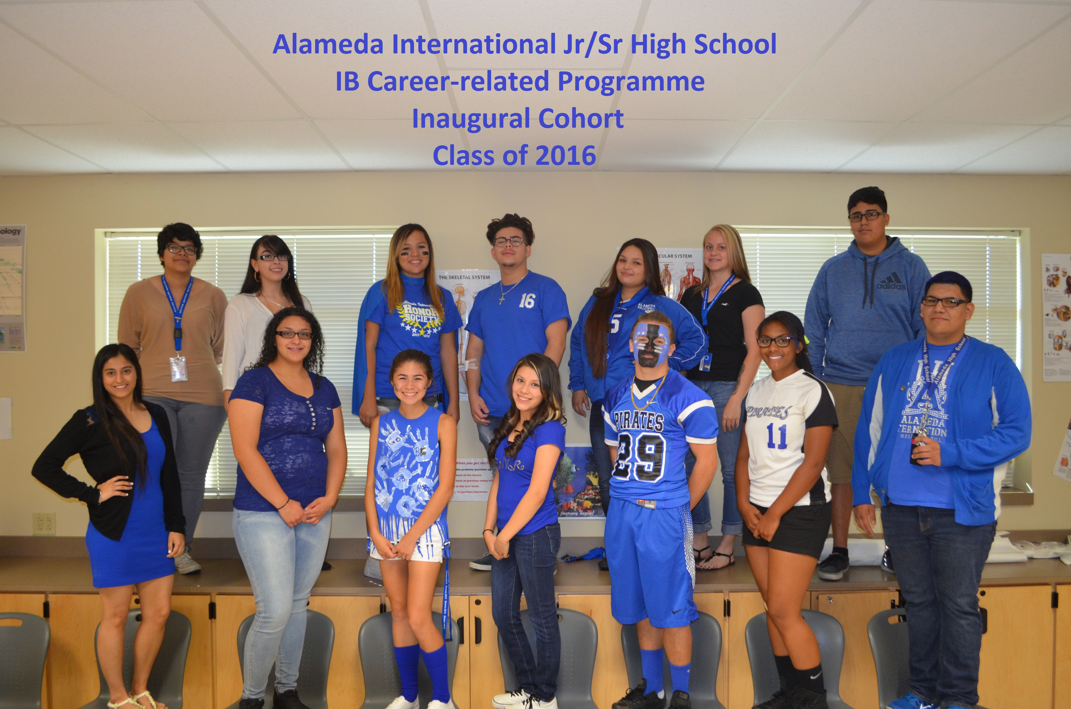
Summarizing the Keys:
Commitment
District
Staff
Students
Flexibility
Scheduling
Courses
Pathways
Resources
Financial
Training
Staffing
Community
Community Connections
Business
Post-Secondary
Parents

Slide 30
Questions?
Contacts:
Steve Houwen – IBCP Coordinator: shouwen@jeffco.k12.co.us
Susie Van Scoyk – Principal: svanscoy@jeffco.k12.co.us

Slide 31
Useful Links
Four Questions and Answers about the IBCC (CP)
http://blogs.ibo.org/blog/2014/08/14/four-questions-and-answers-about-the-ibcc/

