Slide 2
Welcome to: How Thinking Routines Promote ATL and Inquiry in Early Childhood Classrooms
Presenters
Melissa Capozza
Alicia Polston
Jessica Studley

Slide 3
Who We Are
Brown International Elementary in Denver, CO. Brown is currently going through its second self-study process.
Melissa Capozza is Brown’s IB Coordinator. She has been a PYP practitioner for 15 years both in the US and abroad.
Alicia Polston is going into her 10th year at Brown in Kindergarten. Alicia is from Memphis, TN, and has taught ECE, 2nd and 3rd grades.
Jessica Studley is going into her 12th year at Brown and will be teaching 4th grade this coming year. She previously taught Kindergarten for 11 years at Brown.

Slide 4
Agenda Objective: Participants will take away exciting new ideas about how to implement thinking routines to promote ATL skills in early childhood classrooms.
Kahoot: getting to know participant background (get your Smartphones and other devices ready to play!);
Online digital collaboration: exploring a digital platform where you can access resources and collaborate with one another during and after our presentation;
Thinking Routines in Action: a glimpse into our classrooms and the routines that promote the Approaches To Learning skills;
Wrap up: time to reflect and celebrate our time together!

Slide 5
Getting to know participants
Please access the site Kahoot.it and get ready to play!

Slide 6
Active participation through Trello
Trello is an online collaboration tool that organizes projects into boards. In one glance, users can access resources, activities and message boards unique to your project.
Our Trello address for this presentation is
http://bit.ly/2a0SeBv
Using this address, you can access, in real-time, the activities we will outline, videos of examples of the thinking routines in action in our classrooms, resources and messages from attendees to this breakout session.

Slide 7
How Thinking Routines Promote Approaches to Learning
Last year, our school’s Professional Development Unit focused on thinking routines examined in the text Making Thinking Visible
This PDU aligned with the LEAP framework under which teachers are evaluated throughout our district.
Let’s review the Approaches to Learning (ATL) skill categories.
Self-management skills
Social skills,
Communication skills
Thinking skills
Research skills.
Through combining MTV and ATL protocols in early childhood classrooms, there is potential to achieve the standard of growth we are expected to attain in developmentally-appropriate ways, while also meeting the professional expectations of public school districts.

Slide 8
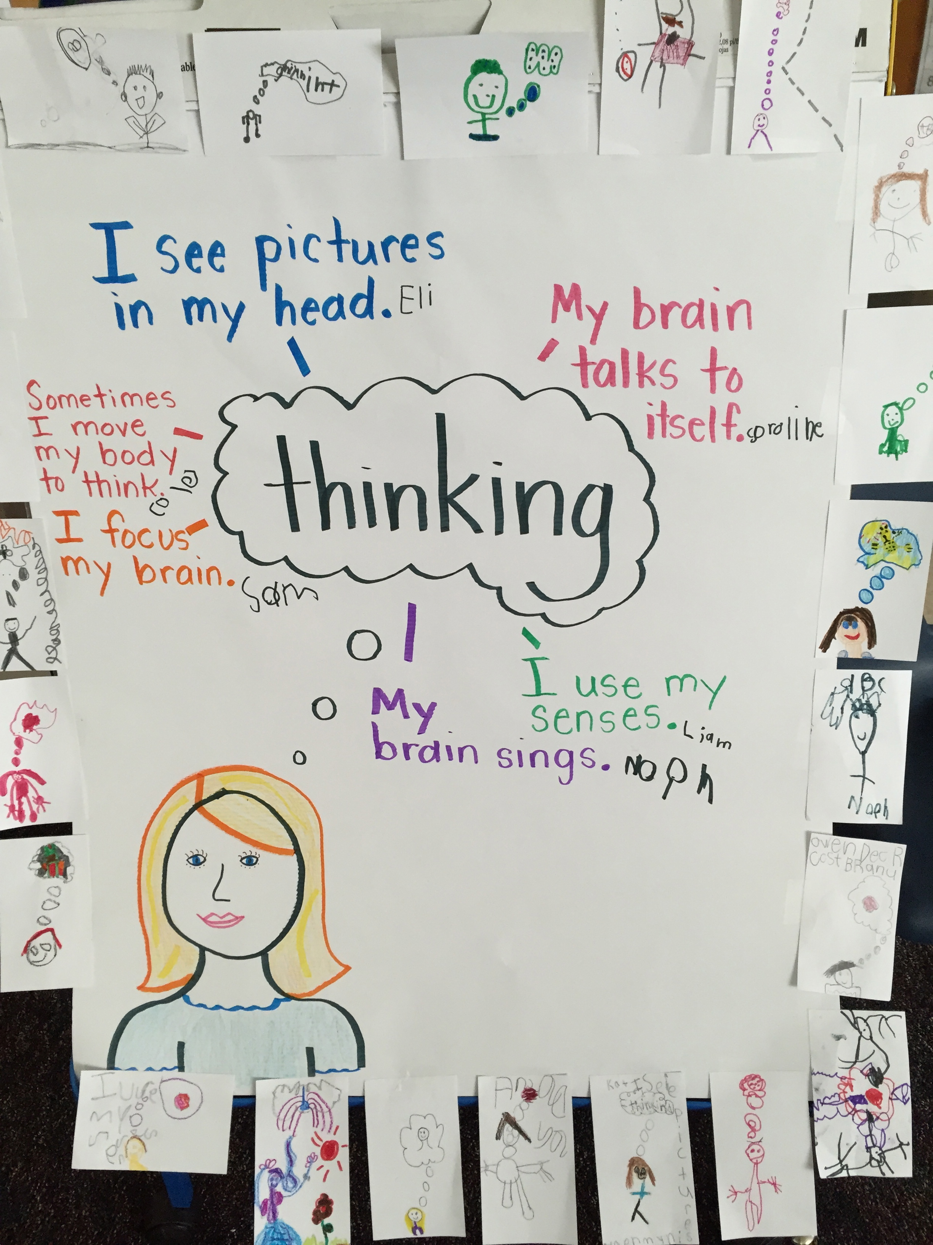
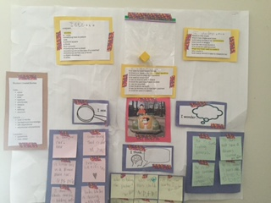
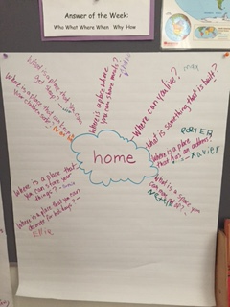
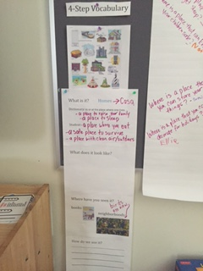
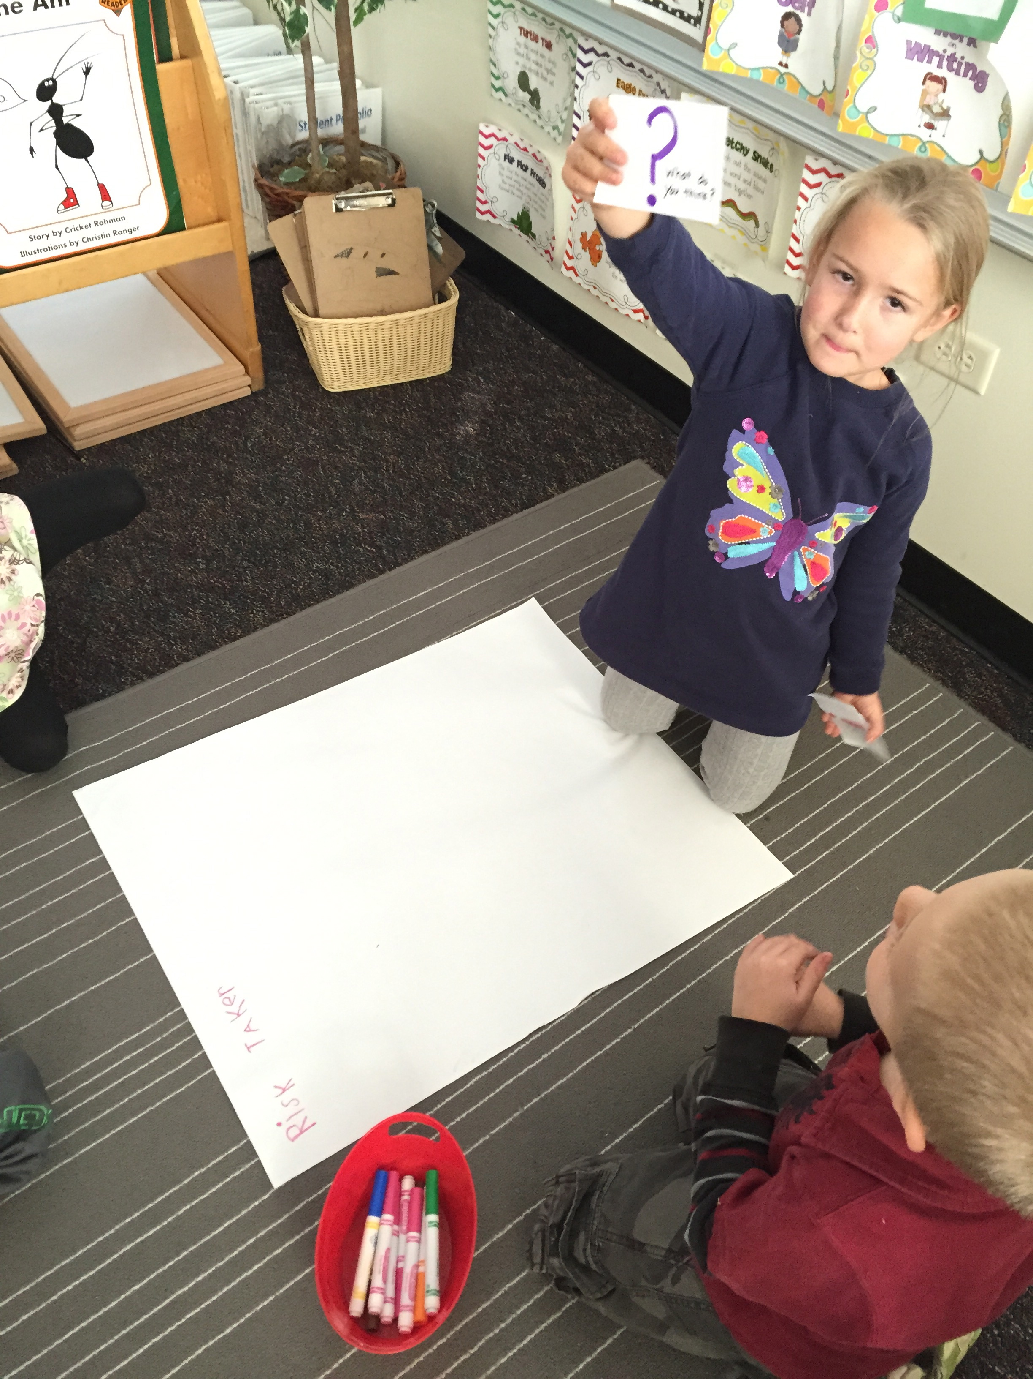
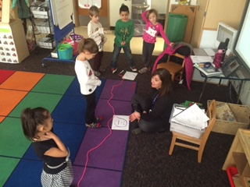
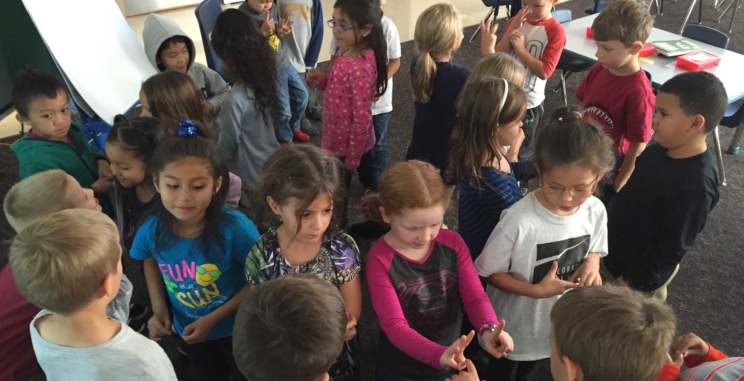
Let’s dig into some thinking routines and explore how they promote ATL skills and inquiry in early childhood!

Slide 9
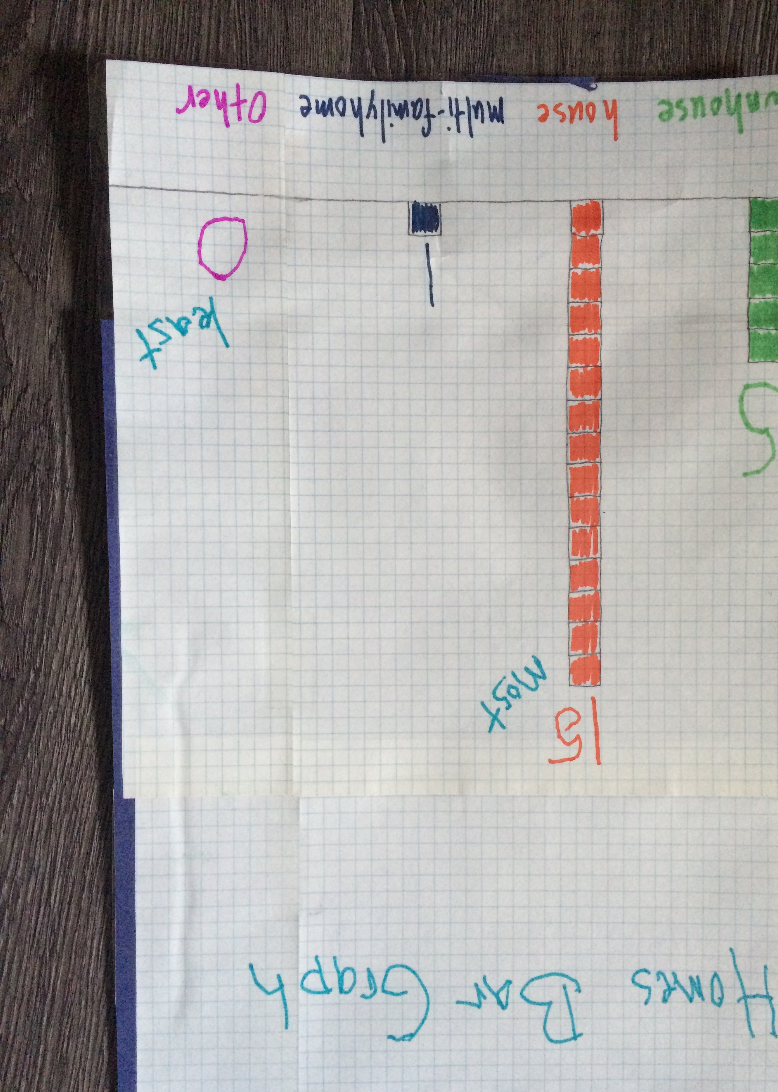
The CORI Method ATL Skills addresed: Communication, Social, Self-Management, Research and Thinking
Collect: students collect data on a specific subject.
Organize: students collaborate to decide how to best organize the data they’ve collected.
Reflect: after organizing the data, students look for patterns, generalizations and outliers.
Illustrate: students decide how to display and communicate their findings.

Slide 10
Answer of the Week ATL Skills addressed: Communication, Research and Thinking
Answer of the Week is a routine we use to promote higher-level and backwards thinking with our early-childhood students.
*Hint: start simple
(e.g. Birthday)

Slide 11
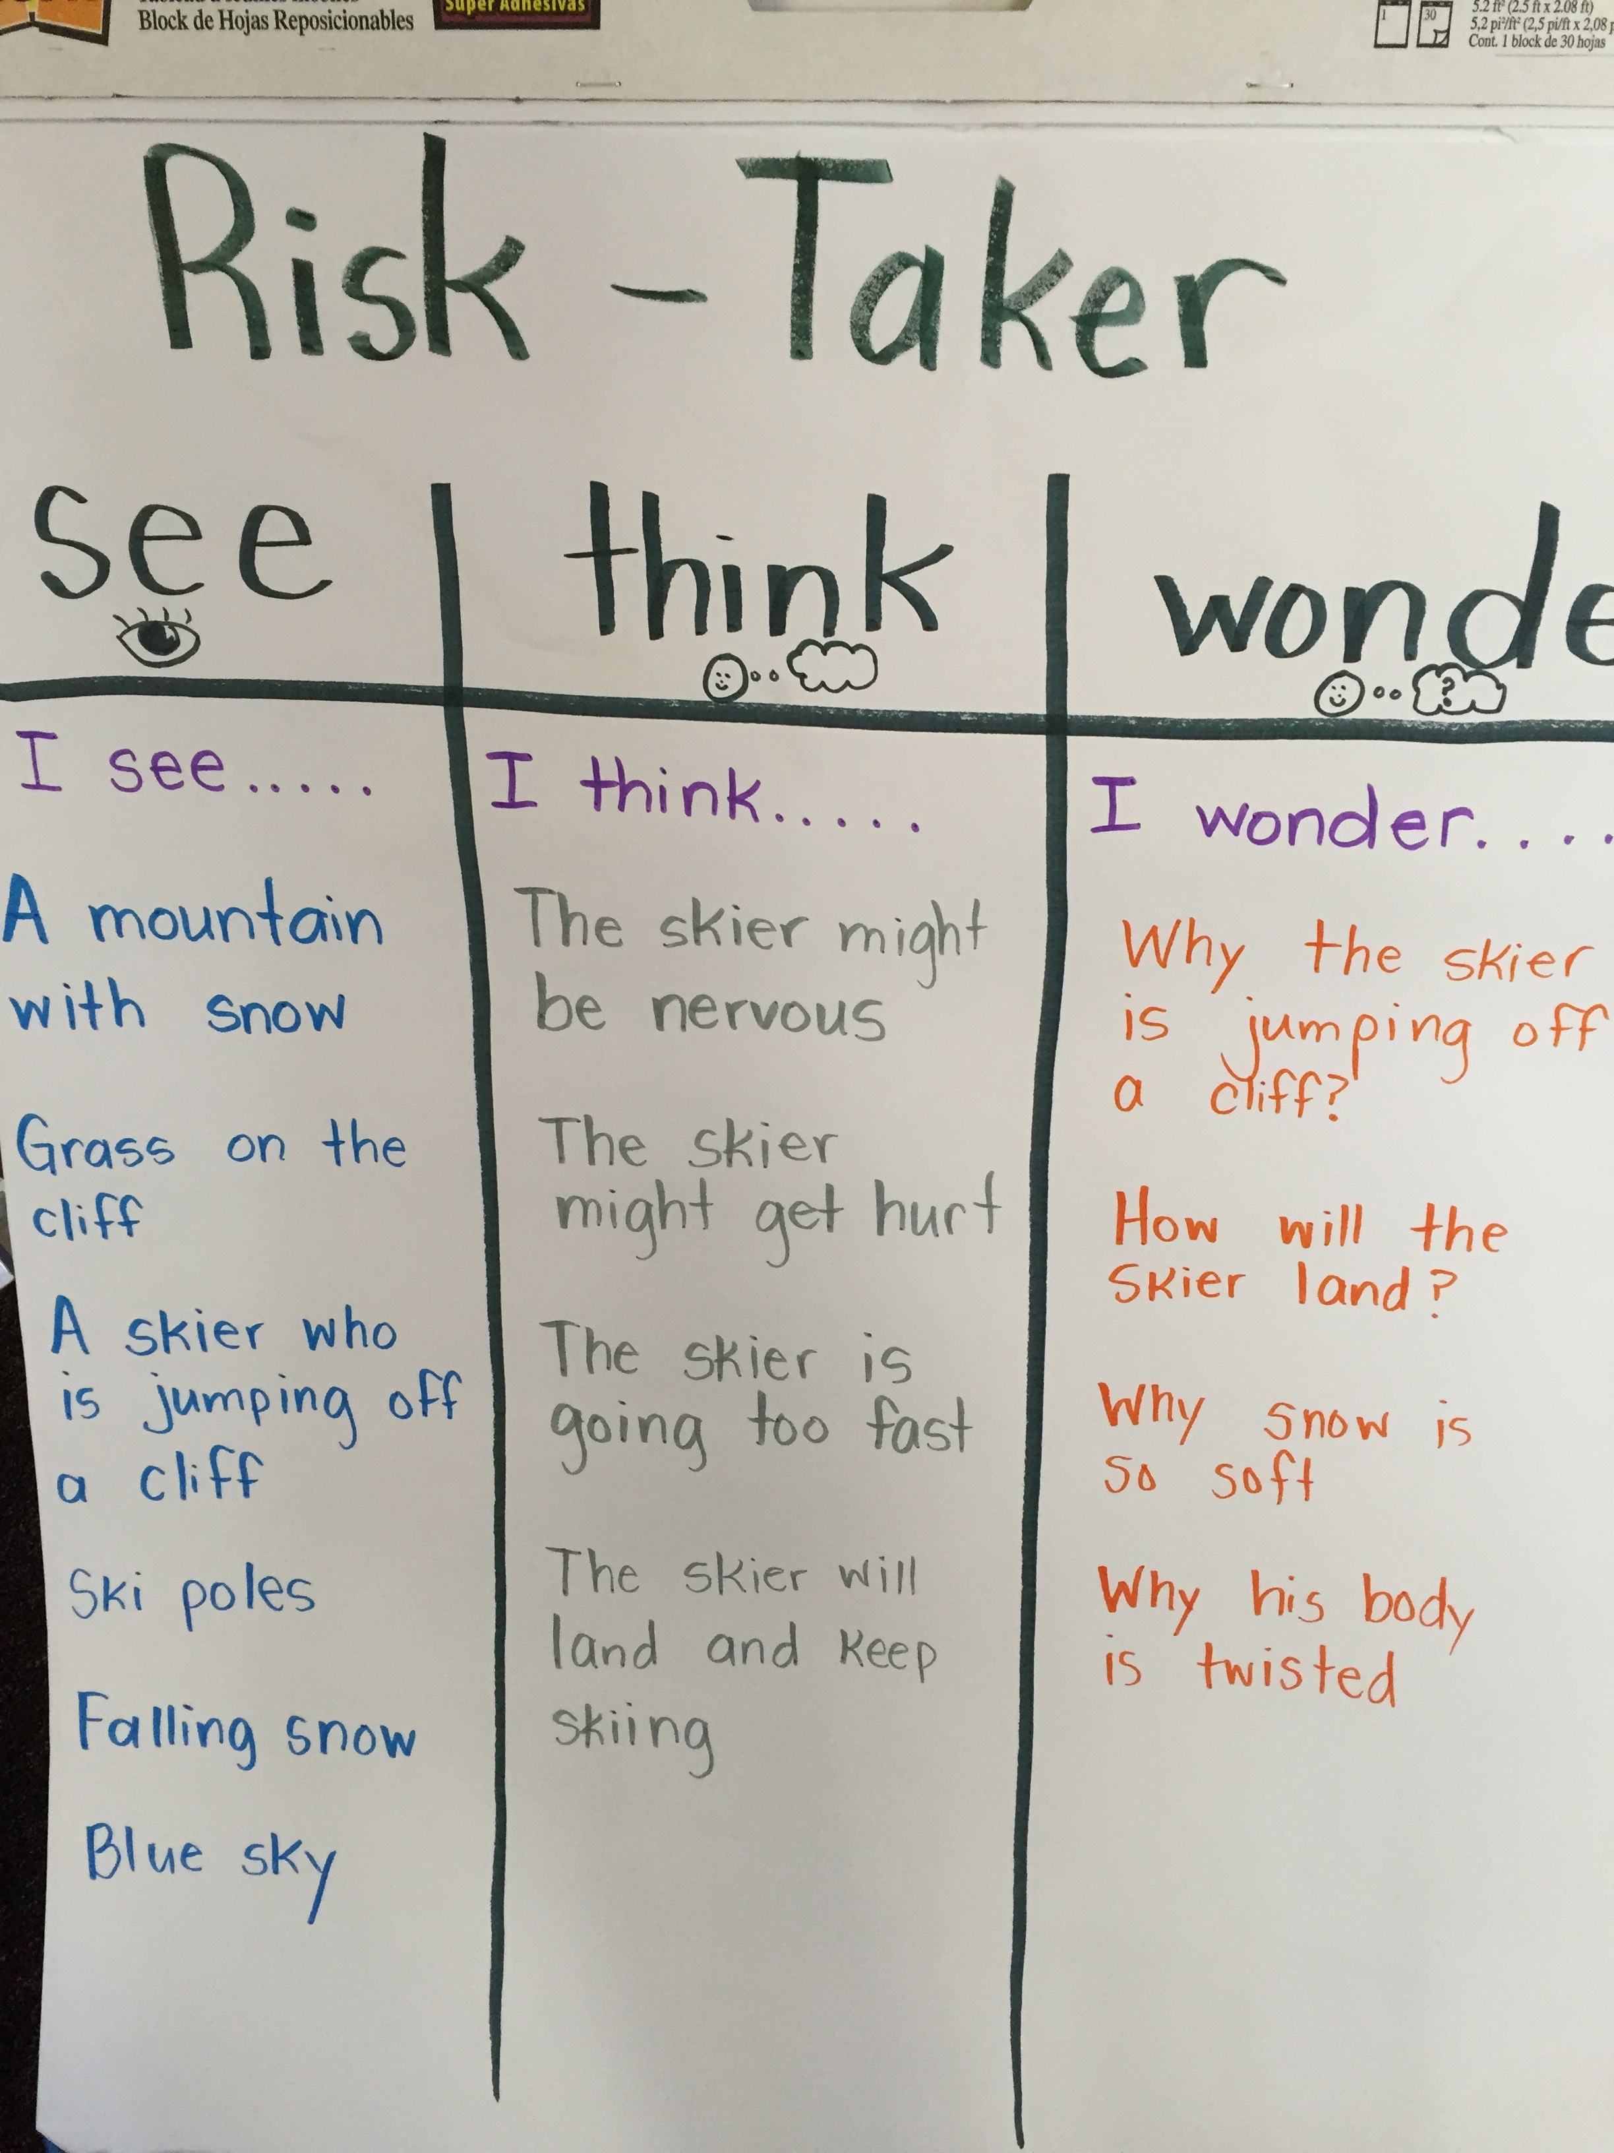
See, Think, Wonder ATL Skills addressed: Communication, Research and Thinking
Where can we find that?
That’s an important point!
!
What do YOU think?
?
As a whole group, students participated in a See Think Wonder routine about being a risk-taker. They were shown a picture of a man wearing a Viking helmet sledding down a hill racing others.
After our whole group activity, they were divided into five small groups and given roles (facilitator, recorder, etc.) with a unique picture of a risk-taker to create their own STW charts.
Each group was given cards to engage their group in accountable talk including: ‘That’s an important point’, What do YOU think?, and ‘Where can we find that?’
The facilitator ensured the group stayed on task, the recorder wrote what the group said and the note-card holder kept the conversation going by holding up the accountable talk cards when appropriate.

Slide 12
Circle of Viewpoints ATL Skills addresed: Communication, Social, Research and Thinking
Circle of Viewpoints provides a scaffold for helping students examine an issue from multiple points of view. Students become actors or actresses and take the role of the character whose viewpoint is being examined. This is not only a valuable life skill but also requires students to engage in multiple types of thinking including analysis, inference and synthesis to determine what the viewpoint might be. The prompts for this routine are:
"I am thinking of (an event or issue) from the point of view of ____________.”
"I think _________________(expressed in first person, as if the student were the character).
“A question or concern I have from this viewpoint is _________"

Slide 13
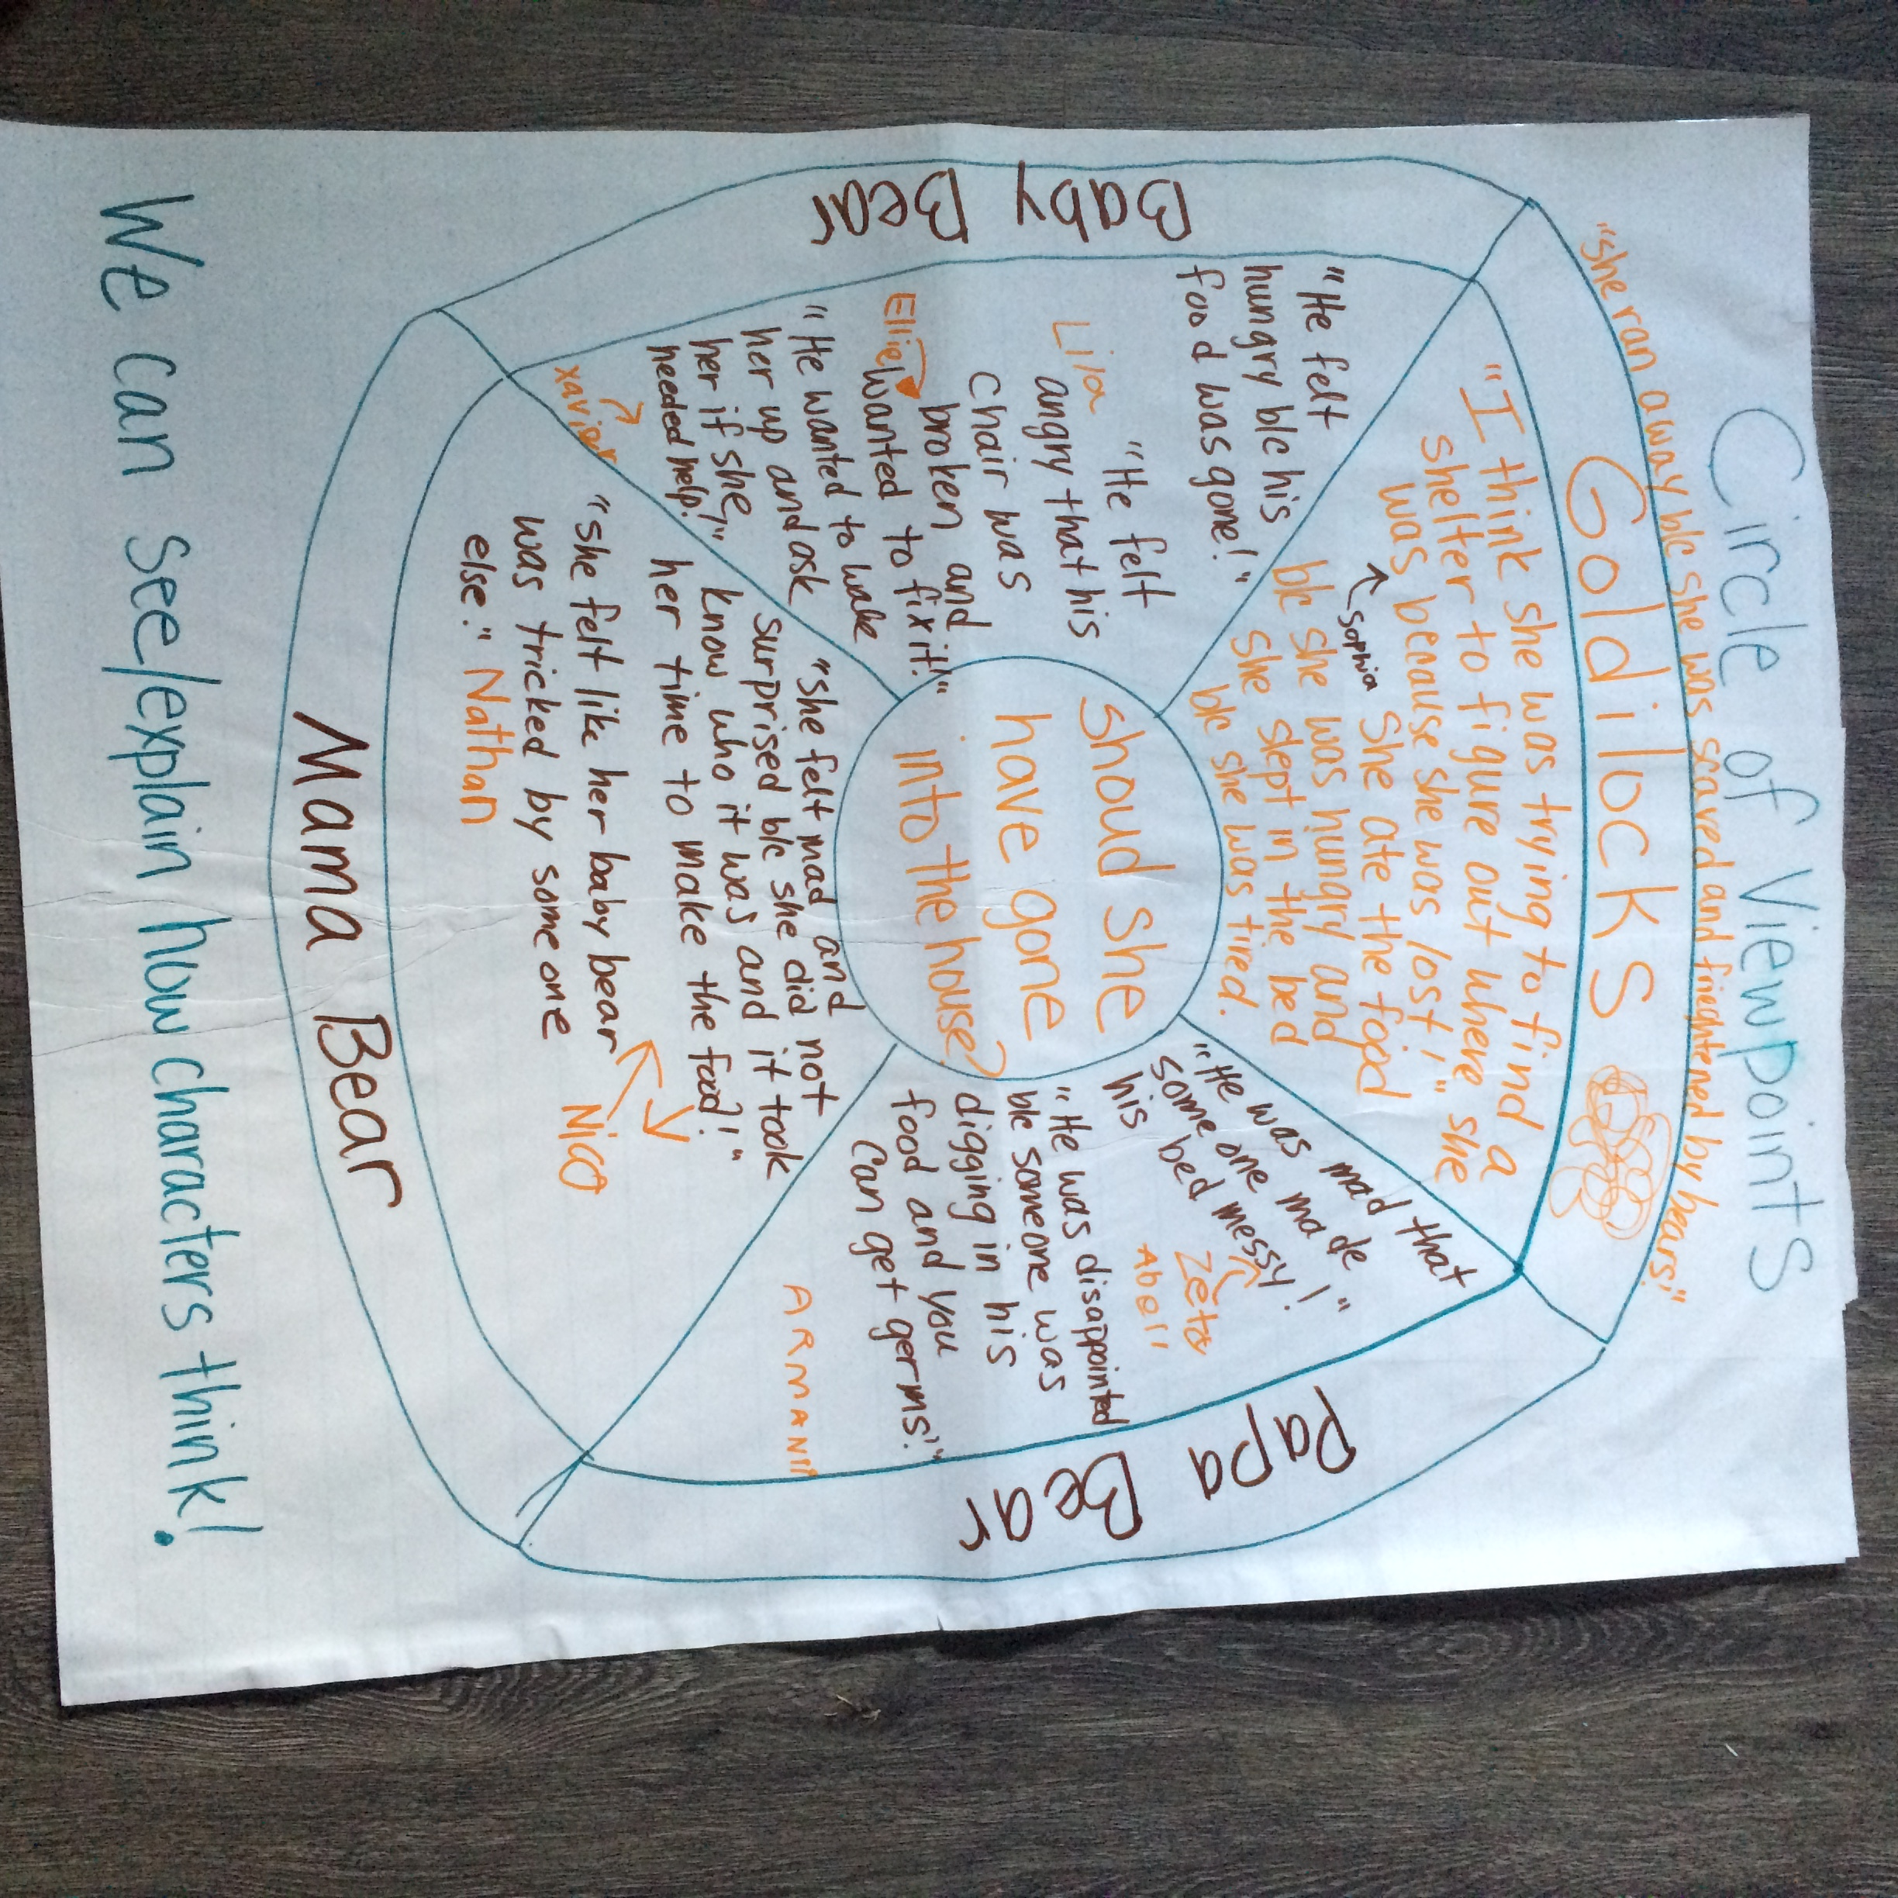
Circle of Viewpoints artifact

Slide 14
Tug of War ATL skills addressed: Communication, Social, Self-Management, Research, Thinking
Tug of War is a routine for digging deeper into a subject. It can be used with curricula or to gain insight into classroom social issues. The best part about this routine is that after it is established in your classroom, it can be used at any moment when there are two sides to an issue that need to be explored more deeply. This is how it works:
Identify an issue with two sides
Students take a stand by generating "tugs" for each side of the issue. Every student must take a stance on both sides!
Generate reasons for each tug then rank the strength of the reasons, placing the strongest arguments at the end of the tug of war rope just as you would place the strongest participant as the anchor in a real tug of war. Then line up the rest of the tugs on each side in order of strength.
Discuss the outcome, noting any lingering questions as well as how individual thinking might have changed over the course of the exercise.

Slide 15
I Used to Think, Now I know ATL Skills addressed: Communication, Research, Thinking
This is a great extension to the See, Think, Wonder routine. Using your initial STW chart, students can more easily access what they used to think vs. having to recall on memory after they’ve learned quite a bit about the content.
This routine also helps students piece together parts of content learned into a whole. For example “I used to think life cycles weren’t important. Now I know they are.” versus “I used to think life cycles weren’t important, now I know they are because they are connected together like trees giving us oxygen.”
Let’s check out some videos of the kids in action!

Slide 16
Thinking Maps ATL skills addressed: Thinking, Research, Communication
This routine is designed to facilitate metacognition about how students think.
Part of the MYST protocol, which is a routine to help teachers prepare and reflect on making thinking visible.
Me: How do I make my own thinking visible?
You: How do I make my students’ thinking visible?
Space: How is space in the classroom organized to help facilitate thinking?
Time: How to I give thinking time? How does thinking develop over time?

Slide 17
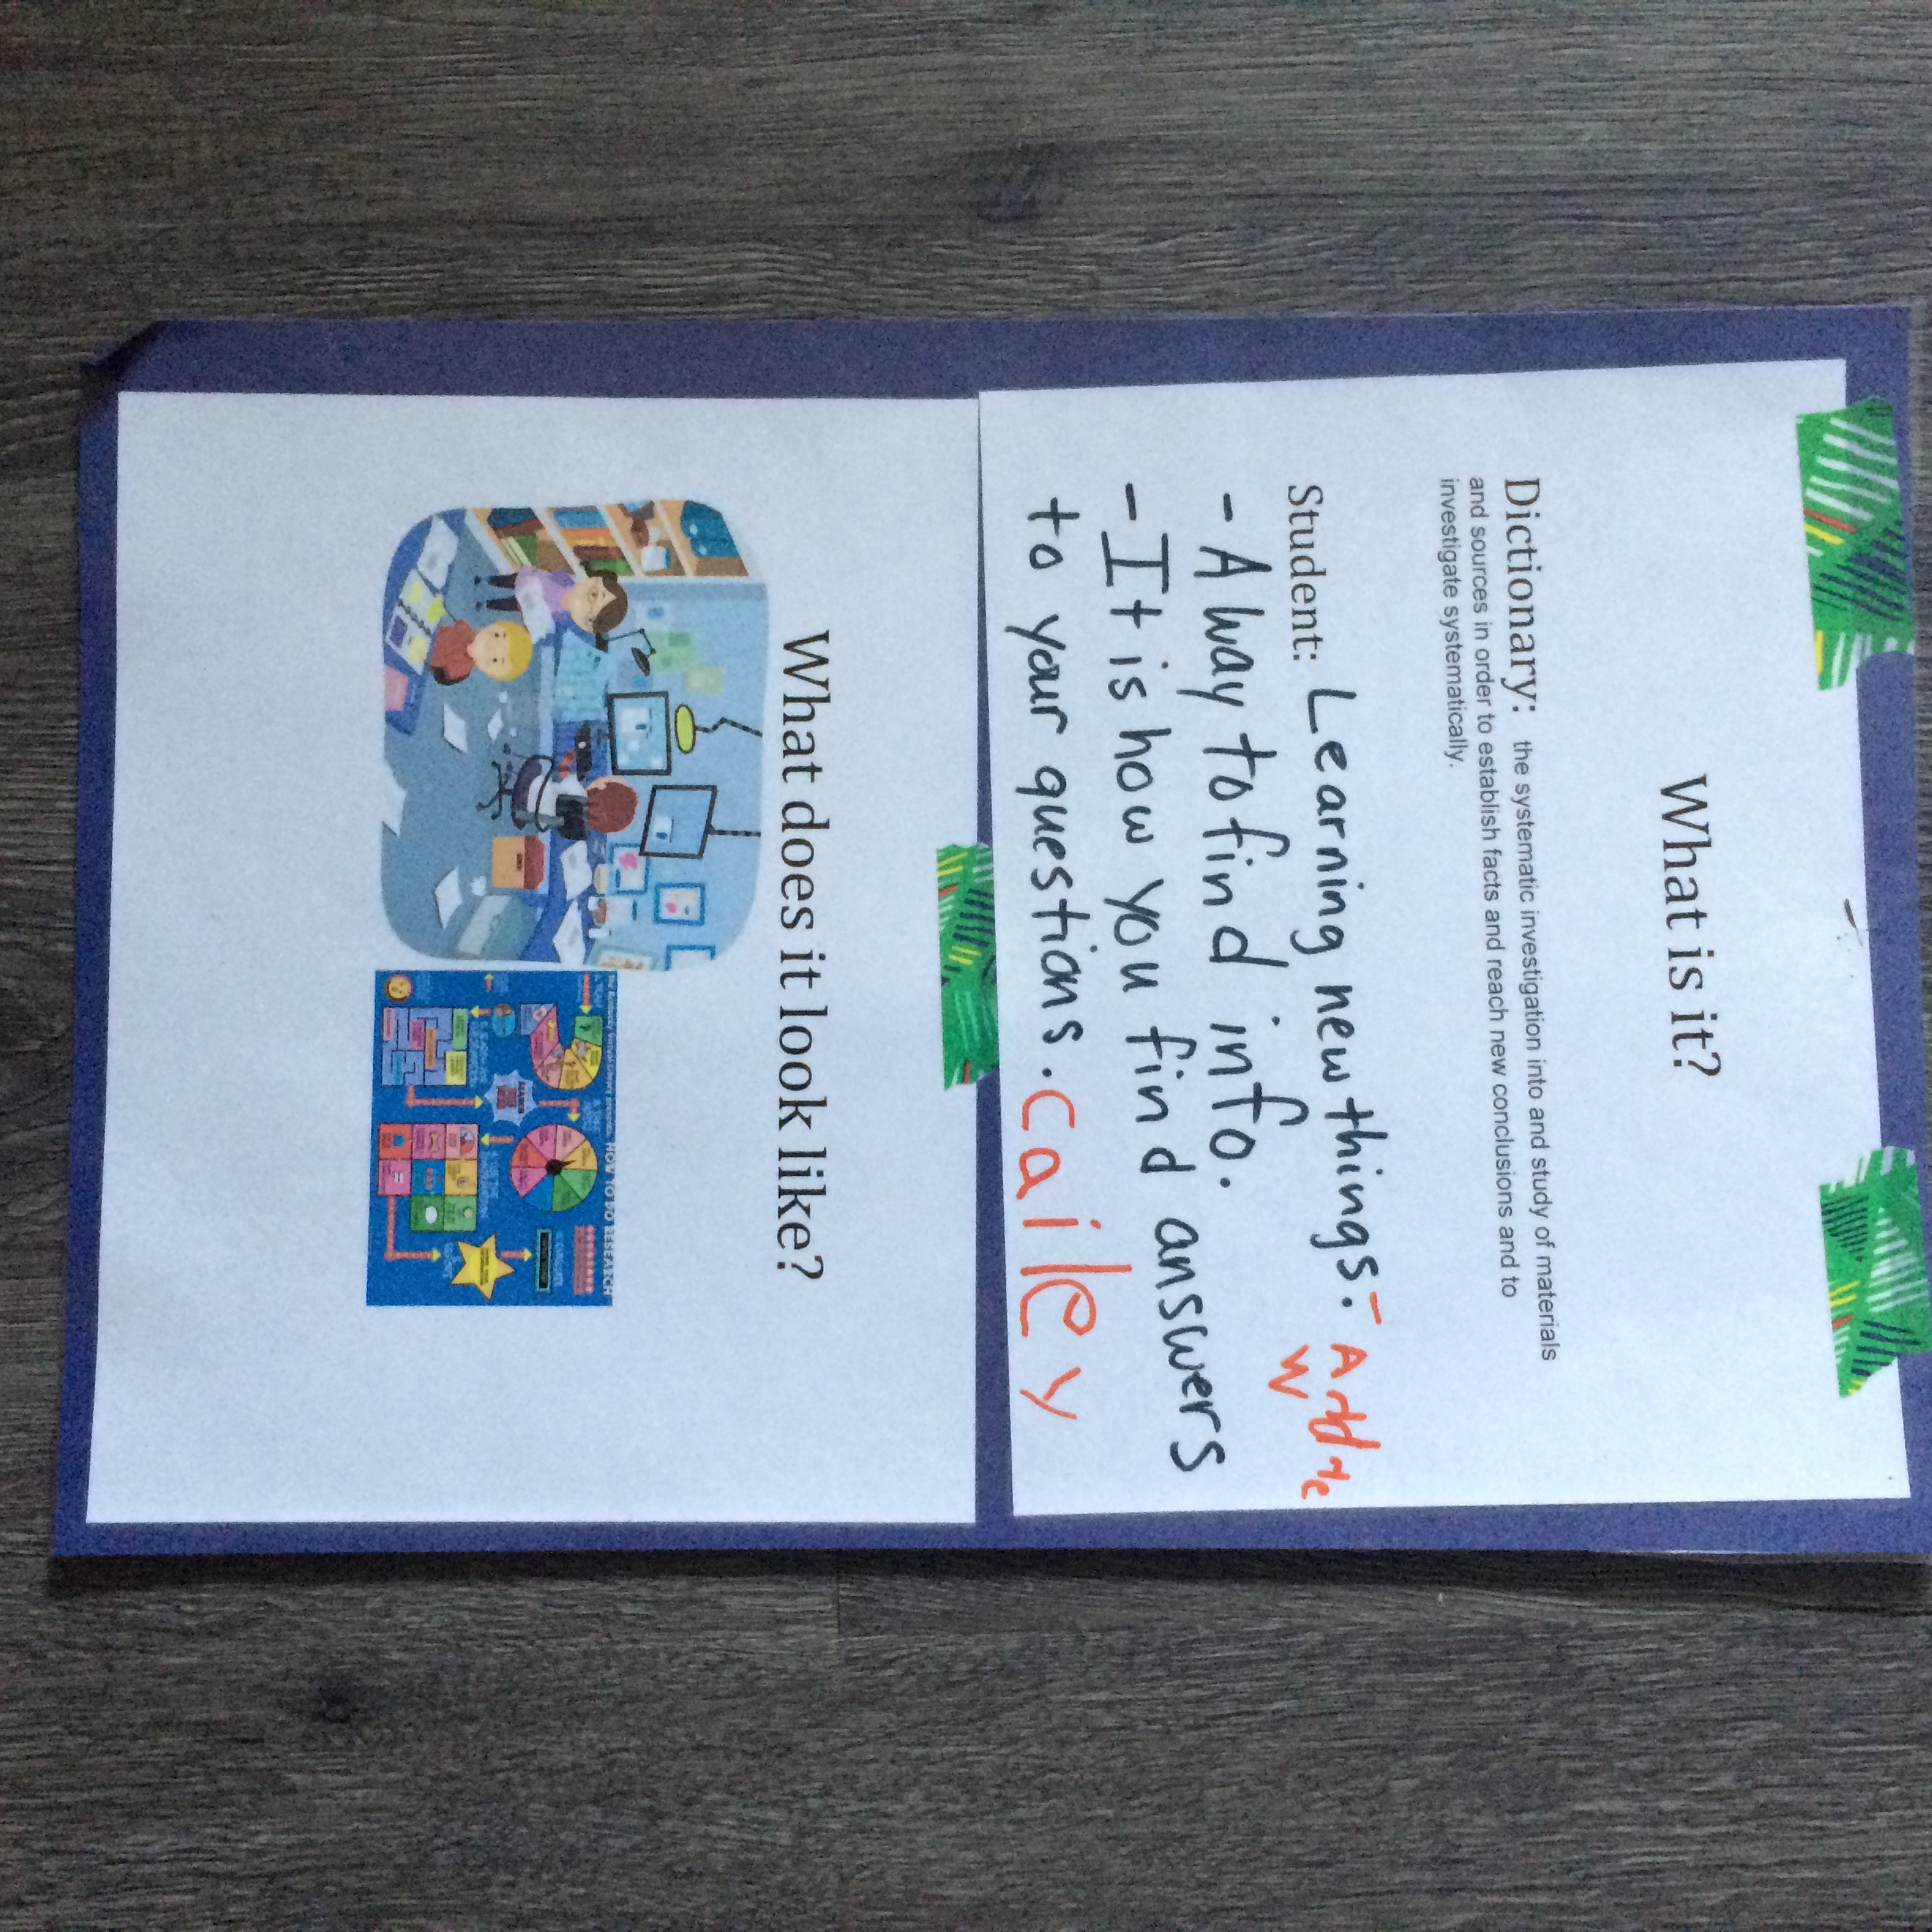
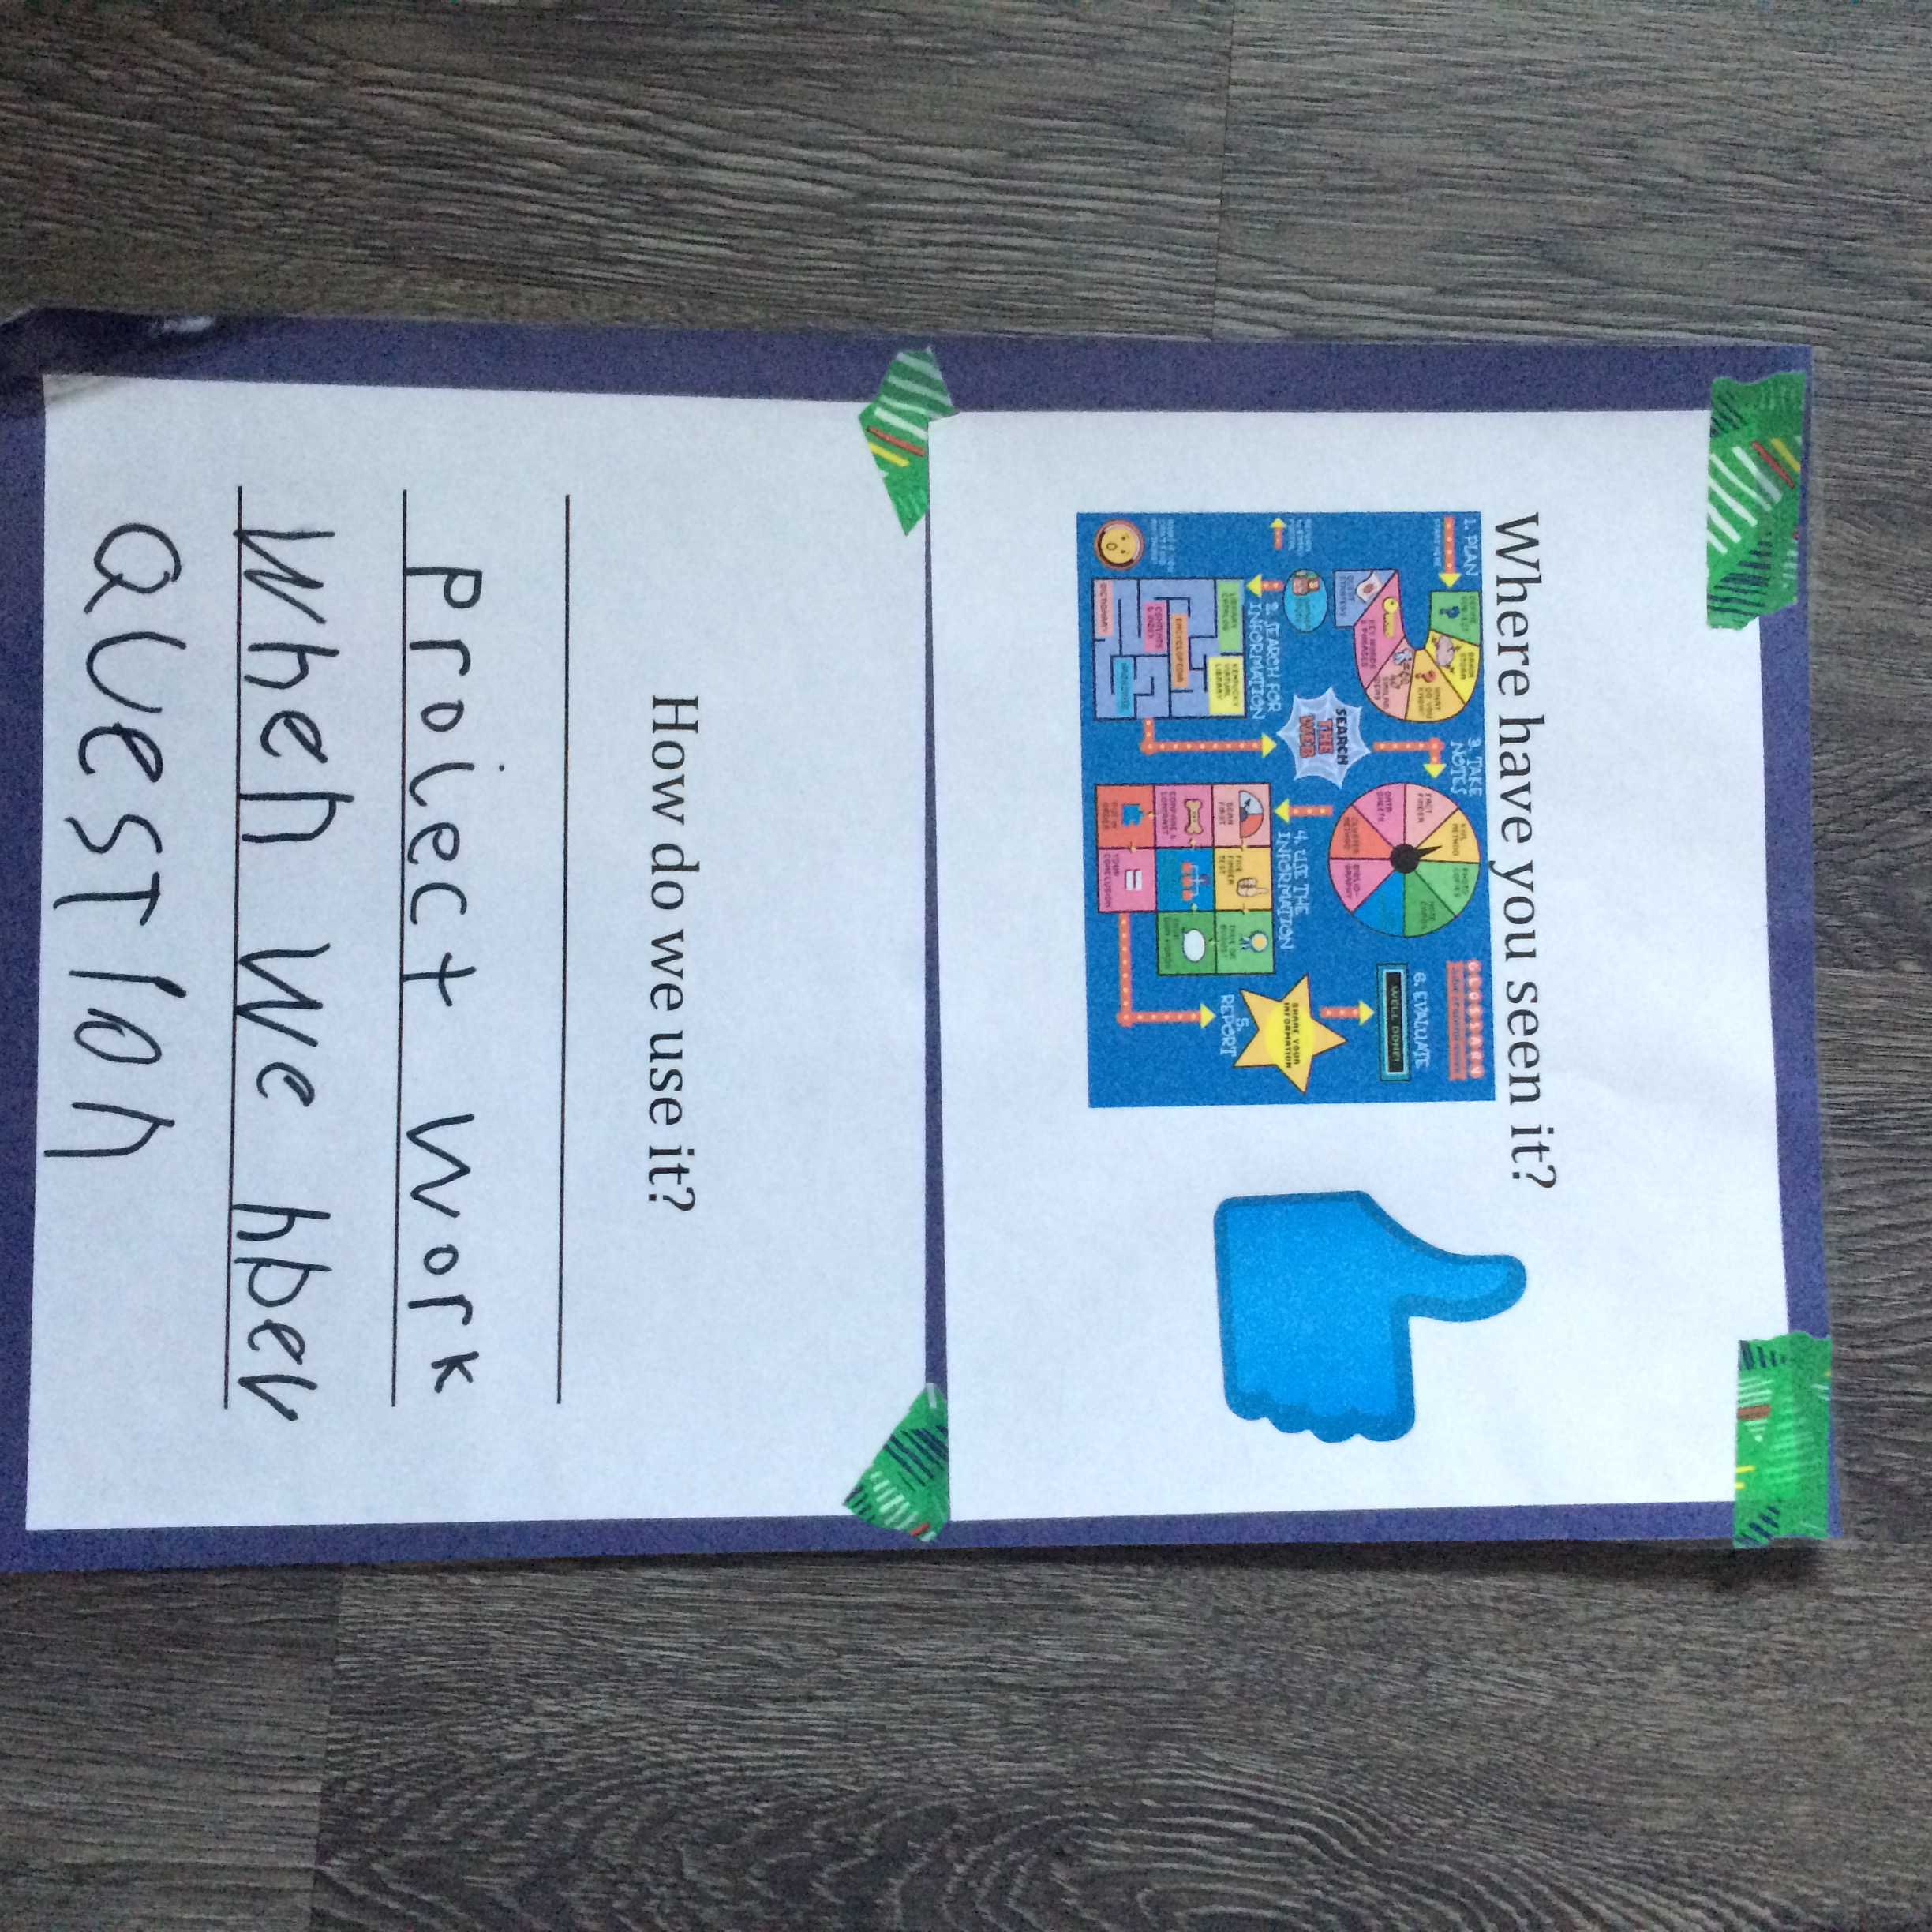
Four-Step Vocabulary ATL skills addressed: Self-Management, Thinking, Research, Communication
Four step vocabulary is a thinking routine which, if implemented on a consistent basis, will help enrich not only student writing, but oral communication and overall comprehension.
In this routine, students define a word, usually linked to the current unit of inquiry, answer what does it look like, where they have seen it and how we use it.

Slide 18
Trello
Trello is an amazing ongoing resource management tool that makes collaboration easy and even fun. This visual listing system is multi-faceted in that photos/videos can be shared, precise resource links are listed along with document downloads. We have listed information for your reference on this Trello along with additional videos to build inspiration. This board can also connect people in discussions and afford the opportunity to ask questions. It also links all of the people from that specific event on that page to build future collaboration and friendship!

Slide 19
THANK YOU for attending and staying! Check under your seat for a number. There are five possible winners of an IB t-shirt.
Melissa Capozza: melissa_capozza@dpsk12.org
Alicia Polston: alicia_polston@dpsk12.org
Jessica Studley: jessica_studley@dpsk12.org

