Slide 1
The Gifted Challenge and IB
Peggy Healer, EdD
peggygoodhealer@hotmail.com
phealer54@gmail.com

Slide 2
Session Objectives
1. Share and validate challenges and benefits of meeting the needs of exceptional students within the International Baccalaureate Transdisciplinary framework
2. Explore program ideas to address needs of gifted students in alignment with state/provincial requirements and the International Baccalaureate Standards and Practices
3. Explore Inquiry learning experiences to affirm student identify, build student self esteem, value prior knowledge and scaffold and extend learning
Notes:
Turn to your table group and share challenges of

Slide 3
Our Gifted- IB Story
Background with IB and Gifted
History of changes with Gifted Program in alignment with the IB PYP
Research on Science through a transdisciplinary Approach
Current results after two years of change
Notes:
Peggy shares her journey about gifted and IB.

Slide 4
Gifted Education and IB
Brainstorm with your teammates from your school and/or district your current understanding of IB and meeting the needs of gifted – record understanding on chart paper
Brainstorm with your teammates from your school and/or district your current understanding of meeting the needs of your gifted students in your district/school- record on chart paper

Slide 5
Meeting the needs of gifted students through the IB PYP Framework
Share your Gifted Story Challenges with your table group.
Claim: “What claims, explanations, or interpretations might you already think you know about IB and meeting the needs of your Gifted Population? Put these on a chart paper
Support: What can we see, notice, know, or find that might give support to claims or refute the claims, etc.
Question: Is there evidence on the other side?
Share your thinking on chart paper with a claim/support/question section on chart paper
Notes:
Using the Claim/Support/Question Making Thinking Visible (Ritchart, Church, and Morrison, 2011) Strategy: Share what is working and what is not and what you are being told needs to change.
CSQ is a useful strategy as an overarching structure for the examination of ideas and the generation of new understanding. This creates opportunities for learners to reason through complex issues from various angles and perspectives with substantial evidence. (pg. 194-195, MTV) Tug of War – both sides

Slide 6
Gifted and Talented or exceptionally able
What do we mean by gifted?
Globally gifted
Gifted in specific areas
Twice Exceptional

Slide 7
Inclusion
Inclusion is an ongoing process that aims to increase access and engagement in learning for all students by identifying and removing barriers
(Learning diversity and the IB Programmes: Special educational needs within the International Baccalaureate programmes, 2010- 2013)

Slide 8
Meeting Student Learning Diversity
All students in an IB World School will experience positive learning environments based upon the IB’s four principles of good practice:
Affirming identity
Building Self esteem
Valuing Prior Knowledge
Scaffolding and extending
learning
Notes:
Meeting Student Learning Diversity in the Classroom

Slide 9
All students are engaged with each other in constructing meaning
Learning accomodates the range of abilities and perspectives that will inevitably exist in a heterogeneous classroom.
Vgotsky (1978) and Piaget (1928)- highlighted the importance of interaction between the learning that is taking place in the social, affective and cognitive domains.
PYP believes that students’ learning and their attempts to understand their world around them are essentially social acts of communication and collaboration
“ The Primary Years Programme as a model of transdisciplinary learning (pg. 15-16)
Notes:
“ The Primary Years Programme as a model of transdisciplinary learning (pg. 15-16)

Slide 10
Differentiation through grouping to support learning in a transdisciplinary context
Dynamic learning environment- students moving from individual work to group work in response to their needs and the needs of inquiries for which they have committed or for that has been designed for them.
Students change roles as they move from one group to another- working as a leader or initiator, a collaborating partner, or a contributing member of a larger group
General education classroom allows for mixed-ability grouping and such groups change continually depending on student needs
“ The Primary Years Programme as a model of transdisciplinary learning (pg. 16).

Slide 11
Message from Michael Clifton
It is the school’s responsibility to ensure that its implementation of the PYP is indeed transdisciplinary in nature and adheres to IB programme standards and practices.
Questions to consider:
Is grouping by ability an effective way and the best way to meet the students’ learning needs? If yes, how has this been proven?
Is the criteria used to group these students based on subjective perceptions and narrow views of intelligence (One or two tests)?
Are educators lowering their expectations of students because of their ability group placement?
If this is an issue this, why wasn’t it an issue last year?
Can the non-mandated accelerated math program be implemented in the home classroom with differentiated instruction?
Is the school ensuring that all students are involved in a transdisciplinary approach to their learning approach to their learning

Slide 12
The Power of Ummmm By Kath Murdoch
https://www.youtube.com/watch?v=LFt15Ig64Ygh

Slide 13
What is an Inquiry Classroom
What is an inquiry classroom? mp4

Slide 14
The PYP in Practice
The PYP in Practice Video

Slide 17
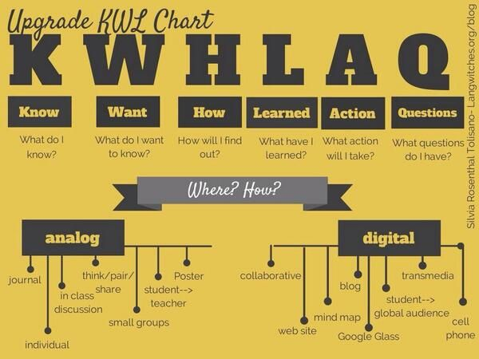

Slide 18
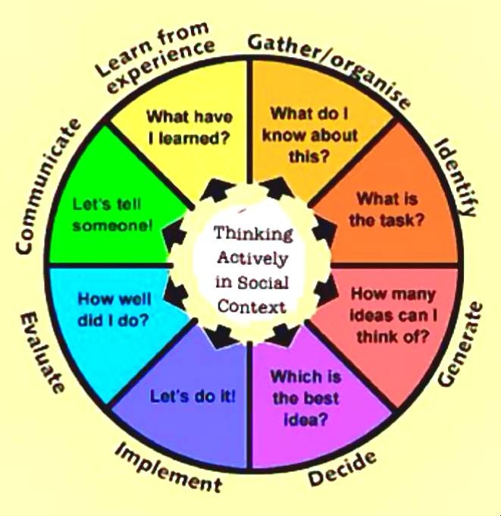

Slide 19
IB PYP Resources to support Student Needs
What is an IB Education? (2012)
Language and learning in IB Programmes (2011)
Learning diversity and the IB programmes: Special Educational needs within the International Baccalaureate programmes (2010)
Programming standards and practices (2010)

Slide 20
Possible ideas for serving Gifted Needs in Compliance with IB
Push in intervention model and a 30 minute/day “no new instruction” intervention period for each grade level: 2-4. During that period, students can be pulled for any intervention (this may include GT, ESL, Special Ed, etc.…)
GT intervention specialists plan and co-teach or partner teach with classroom teachers and work with GT and higher achieving students along with identified students. To accomplish this, there is some clustering of students in certain classrooms so that the GT teacher can work with identified in that space.
Push in/co-teach and minimal pull out method successfully for many years. The goal is to have all interventions happen MAINLY in the classroom (ESL, Special Ed., GT)
Upside is increased rigor for students who are ready for it because the GT teacher works with more than just identified students since she’s not pulling her students for 300 mins/week. They still get their required minutes, but most of it is in the regular classroom setting.

Slide 21
Growth Mindset
Growth Mindset Feedback
Use these language frames when interacting with your students in the following situations.
When they struggle despite strong effort:
OK, so you didn’t do as well as you wanted to. Let’s look at this as an opportunity to learn.
What did you do to prepare for this? Is there anything you could do to prepare differently next time?
You are not there/here yet.
When you think you can’t do it, remind yourself that you can’t do it yet.
I expect you to make some mistakes. It is the kinds of mistakes that you make
along the way that tell me how to support you.
Mistakes are welcome here!
You might be struggling, but you are making progress. I can see your growth (in
these places).
Look at how much progress you made on this. Do you remember how much more
challenging this was (yesterday/last week/last year)?
Of course it’s tough –school is here to makes our brains stronger!
If it were easy you wouldn’t be learning anything!
You can do it – it’s tough, but you can; let’s break it down into steps.
Let’s stop here and return tomorrow with a fresher brain.
I admire your persistence and I appreciate your hard work. It will pay off.
Notes:
As students begin to work on their learning objectives, growth minded language guides and motivates them to ensure that they remain persistent, resilient, and focused on the process of learning. It is important to give learners feedback about their progress and their results so they can specifically see their growth.

Slide 22
Possible Challenges
Nature of ability and implications for learning
Students may:
Reason well (good thinker)
Learn rapidly
Have extensive vocabulary
Have an excellent memory
Have a long attention span (if interested)
Be sensitive (feelings hurt easily)
Show compassion
Be perfectionists
Be intense
Be morally sensitive

Slide 23
Challenges continued
Have strong curiosity
Ask lots of questions
Draw inferences
Invent things
Love challenges and complexity
Have a high degree of perseverance in their interests
Have a high degree of energy
Prefer older companions or adults

Slide 24
Teaching Strategies
Provide a safe, affirming environment to build confidence and self-esteem
Cooperative, knowledgeable, accessible schools that welcome parents into the learning partnership are best placed to support the students in overcoming challenges and to optimize learning experiences
Teach in line with the IB’s approaches to learning and IB’s four principles of good practice
Support learning in areas in which less satisfactory progress is being made

Slide 25
Teaching strategies should:
Ensure learning extension in areas in which the student’s exceptional ability is demonstrated
Ensure students are challenged to go deeper, with the content taking into account pace, depth and complexity, as opposed to providing more of the same.
Create opportunities for students to undertake studies and or programmes at a higher level in areas of exceptional ability (via other organizations and universities).
Allow students to undertake studies in different and additional areas of interest

