Slide 2
Make Some Space
Incorporating Specialist Teachers Into the PYP Planner
Keri Harrison & Ashleigh Woodward

Slide 3
Introduction & Agenda
Who We Are
Where We Are In Space and Time
How We Organize Ourselves
Notes:
AW - teaching roles & MacLachlan College; how we got to this point (self-study); Organize for Agenda: 1. What does the IB say; What does it look like for specialist teachers; integration strategies; looking at examples; finishing up with collaboration strategies

Slide 4
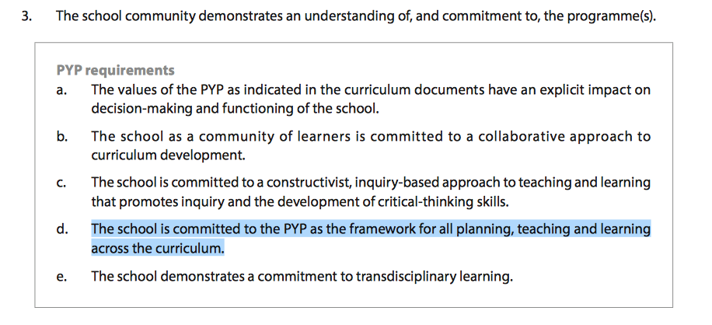
What Does The IB Say?
Standard A #3
Notes:
KH - intro - read each

Slide 5
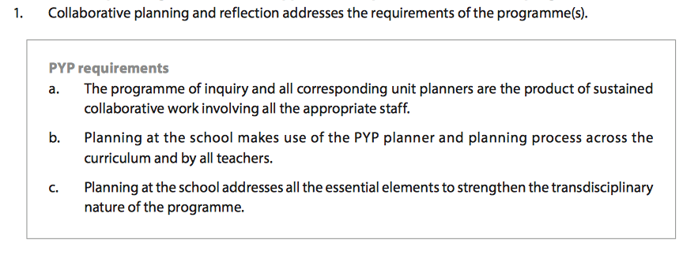
What else do they say?
Standard C1

Slide 6
They say more?
Standard B2 #3a and #4
Standard C1#3

Slide 7
Looking at the Arts and PSPE S&S...
There is a lot of information there! Perhaps because these are the most common of the single-subjects?
For example, “It is acknowledged that in many schools, single-subject teachers take responsibility for different arts areas. It is vital that these teachers see themselves primarily as PYP teachers who teach arts, and in so doing contribute to the overall outcomes of a transdisciplinary programme. To ensure a cohesive educational experience for students, a PYP school has a responsibility to make sure that there are regular opportunities for collaboration between single-subject teachers and homeroom/classroom teachers. This collaboration includes the development and review of the school’s programme of inquiry, as well as planning, teaching, assessing and reflecting on individual units of inquiry.” (Arts Scope & Sequence)
Notes:
AW to discuss

Slide 8
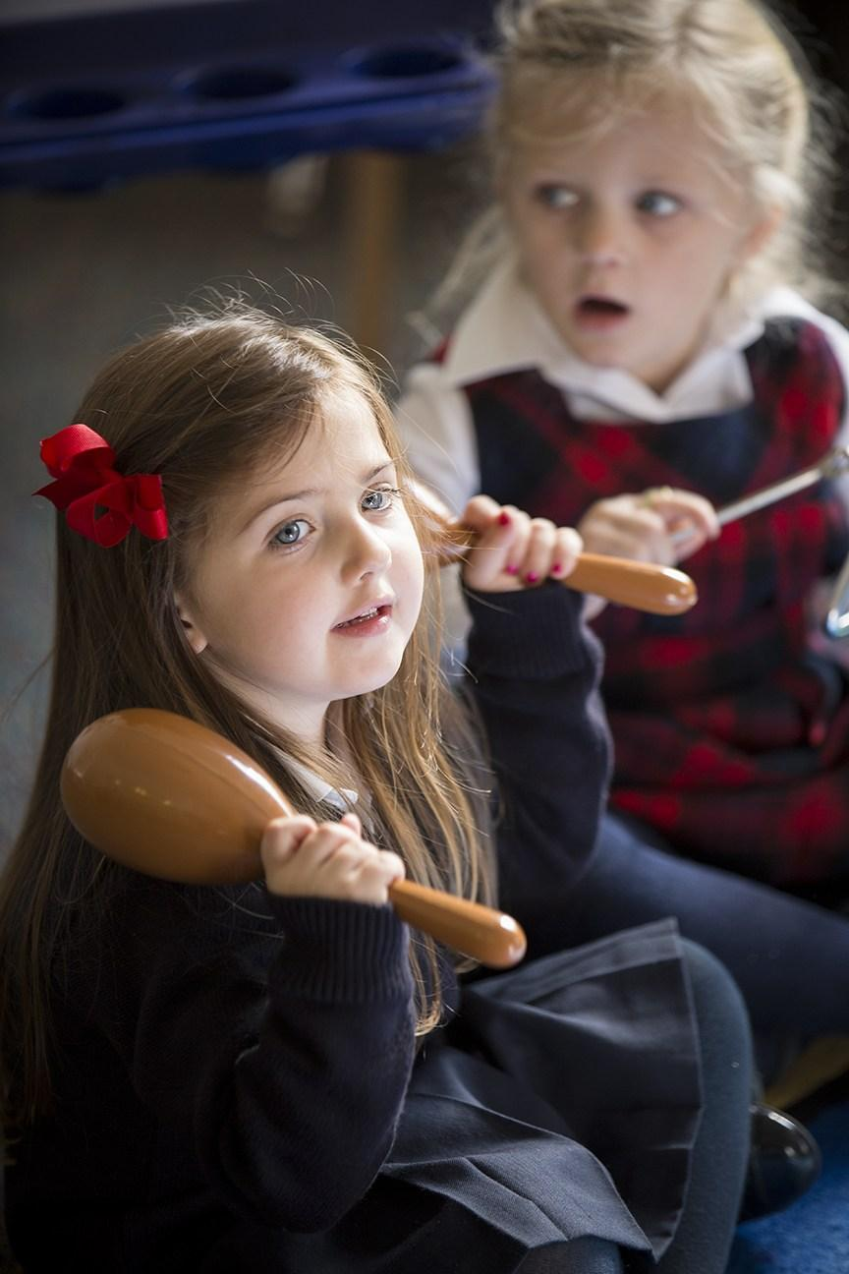
Inquiry-Based, Authentic Programming
Notes:
AW speaks to Gaby’s quotation about integration; KH - example from Kindergarten - how I used to add a game, now I connect

Slide 9
Specialist Teacher Integration Strategies
#1 Developing or supporting a unit within the programme of inquiry: “Whenever appropriate, single-subject teachers should be involved in collaborative planning to plan, teach, assess and reflect on the units of inquiry.” (mod. AS&S)
Notes:
KH - If a single subject teacher is contributing to a unit of inquiry, whatever they are doing should be written into the planner as one of the learning engagements. They should not be running parallel to the unit but they should be part of the unit. Whatever they do contributes to the development of the students understanding of the central idea and/or development of knowledge and skills to help students understand the central idea. They will not have a separate summative assessment.

Slide 10
Specialist Teacher Integration Strategies
#2 Preparing for or following on from a unit within the programme of inquiry: “The direct teaching of single-subject teachers in a unit of inquiry may not always be feasible but, where appropriate, introductory or follow-up learning experiences may be useful to help students make connections between the different aspects of the curriculum. Single-subject teachers may plan and teach activities or experiences that prepare students for participation in a unit of inquiry. Following on from a unit, students may demonstrate their understanding of the central idea in a single-subject context.” (mod. AS&S)
Notes:
KH -

Slide 11
Specialist Teacher Integration Strategies
#3 Independent inquiry: “There may be times when teachers will be teaching aspects of single-subjects independent of the programme of inquiry using purposeful inquiry. At such times, teachers should structure their teaching and learning through the use of the PYP planning process. Teachers should ensure that authentic connections are made while maintaining the integrity and essential character or learning in, through and about specialist subjects. If undertaking an inquiry outside the programme of inquiry, teachers should still recognize that the same philosophy and pedagogy must underpin their planning of the subject.” (mod. AS&S)
Notes:
AW - Single subject teachers can also write their own unit of inquiry if they have a big idea within their subject area they want students to inquire into. This unit is not part of the POI but in true PYP fashion it follows the planning process of the planner: A. What do I want the students to understand? B. How will I know they have understood it? C. What do my students need to know, be able to do to go from A. to B:?

Slide 12
Looking At Planners...
You may be a part of a homeroom teacher’s unit of inquiry or create your own, but both use the planner.
Some effective ways of ‘connecting’ include through:
Central ideas
Lines of inquiry
Key concepts
Notes:
KH

Slide 13
Connecting Through Central Ideas:
Consider ‘opening up’ your central idea. For example, change “Art” to “The Arts” or “experiments” to “experiences.”
The following are some central ideas from IB documents and other planners. As we cycle through them, discuss how the single subjects at your school might be able to connect to these central ideas.
Notes:
AW - talk about broadening central idea without losing integrity; explain activity (turn & talk)

Slide 14
Central Ideas #1 and #2
Systems provide a common framework we can use to understand our world.
We use and respond to signs and symbols in different ways.

Slide 15
Central Ideas #3 and #4
3. Identifying, using and describing patterns helps us to make sense of the world we live in.
4. Conflict and peace affect relationships within communities.

Slide 16
Central Ideas #5 and #6
5. Making good choices helps to keep us healthy.
6. Decisions are related to the needs of the individual or the community.

Slide 17
Central Idea Follow-Up
What did you notice about those central ideas?
Why were we able to connect some single-subjects better than others?

Slide 18
Connecting Lines of Inquiry
These too can be ‘broadened’ to explore bigger ideas or deeper concepts.
Lines of inquiry simply must be appropriate to the development level and interests of the students (MTPYPH).
They may be conceptually based, which is a great opportunity for single-subject teachers to connect.
Notes:
KH

Slide 19
Closed to open? An inquiry into...
Specific purposes and characteristics of different transportation systems.
Responsibilities of governments.
The changes in the body system during exercise.
The role of rhythm and music in poetry.
Ways visual media influences consumerism.
The uses of artistic styles and materials.
Notes:
We picked some closed ones, how could they be opened up? Think (2 mins) - Pair - Share (What did you explore?)

Slide 20
Examples of Key Concepts
Can you connect your subject or curriculum to a key concept in that unit of inquiry?
An explicit understanding of each key concept helps students to see those cross-curricular connections.
Notes:
KH - First, spend some time considering this worksheet. Make notes. In two or three minutes, we will break off into our subject-specific groupings to compare.

Slide 21
Use the definitions on your handout to help you think about how your subject’s curriculum can be classified or sorted using the IB key concepts.
form | causation | change | connection
function | perspective | responsibility | reflection

Slide 22
Key Concept Follow Up
I Used To Think...
And Now I Think...
Notes:
(if time permits); share out ideas

Slide 23
If you are contributing to a planner...
Some ways of ‘connecting’ include through:
Central ideas
Lines of inquiry
Key concepts
Opportunities for collaborative assessment arise when you are contributing authentically to a unit of inquiry
But these contributions mean… collaboration.
Notes:
AW - recap and regroup; hit anything missed

Slide 24
Collaboration Strategies:
The same questions crop up for us, time and time again:
When is a good time for everyone to meet?
How can we make best use of our time for everyone?
What do we need to do?
What are some solutions you have found?
Notes:
KH - try and chat with someone from a different school to learn about their best practices or solutions

Slide 25
Collaboration Strategies
Some effective strategies to help our teachers work together to achieve specific goals or targets.
Set an essential agreement for time spent together.
Find shared, respected time that works for all.
Open up to technology or ‘new worlds.’
Recognize strengths and challenges (self and others).
Note outcomes, and follow up if needed.
Notes:
AW - time sensitive as well

Slide 26
In conclusion...
“All PYP teaching staff, whether full-time or part-time, classroom teacher or single-subject teacher, then have the responsibility to develop accompanying planners that correspond to the units on the programme of inquiry.” - Developing a transdisciplinary programme of inquiry (p. 7)
Notes:
AW & KH finish

Slide 27
Where are we (now) in space and time?
A time for sharing or reflection. :)
Notes:
Both Together

