Slide 2
Admissions Case Studies
Chestnut West
July 15, 2016
11:15am-12:30pm

Slide 3
Session Panelists
Kirk Brennan, University of Southern California, Director of Undergraduate Admission
JoBeth Brudner, Linden Tours, Managing Director
Jeffrey Smith, St. Mary’s College of Maryland, Associate Director of Admissions
Kara Turner, Morgan State University, Associate Provost for Enrollment Management and Student Academic Support Services

Slide 4
Types of Universities
Public universities are local and state-funded institutions and are usually large in size.
Private universities are supported by tuition fees and private donations. They typically have a smaller student body, and are more expensive to attend.
Two-year colleges offer programs up to two years that end with a certificate or an associate degree. Included are community colleges, vocational-technical colleges and career colleges.
Four-year colleges offer four-year degree programs that lead to a bachelor's degree. Included are universities and liberal arts colleges.
Liberal arts colleges. Students take a wide variety of courses in the arts, humanities, languages and the social and physical sciences before majoring in a specific field. The faculty’s main purpose is on undergraduate teaching rather than research, and the student population is small.

Slide 5
Types of Universities in the USA
Ivy League: the Ivy League includes some of the oldest universities in the US, and these are considered to be some of the most prestigious and competitive for admissions; acceptance less than 10% of their applicant pool.
Public Ivy describes a group of approximately 30 public universities in the US. These universities have the reputation of being academically rigorous and as prestigious as the Ivies but at a lower cost.
For – profit colleges are businesses that offer degree programs which generally prepare students for a special career. They usually have higher costs.
Institutes of Technology are schools that provides four year programs in science and technology. Some have graduate programs.
Colleges with a special focus or interest include:
Arts colleges – art schools and conservatories of music, schools of dramatic arts
Single-sex colleges- women’s colleges
Religiously affiliated colleges-
Specialized-mission colleges - HBCU

Slide 6
Admissions Approaches
Formula ( numeric) : includes high school GPA, rank and test scores
Comprehensive (holistic) : reviews the entire file, includes the complete application numeric items and essays, recommendations and other information.
Factors considered in Holistic review:
Academic achievement, Quality and Potential- Caliber of High School, course load and evaluative Measures
Non academic characteristics- geography, personal background and qualities, extracurricular activities, leadership and service, other
Source: http://www.collegeboard.com/prod_downloads/press/adm_decision_making.pdf

Slide 7
Different levels of importance to the Factors in The Admissions Decision
​ Factor | ​Considerable importance | ​Moderate Importance | ​Limited Importance | ​No importance
Grades in college prep courses​ | ​84.3% | ​11.9% | ​2.3% | ​1.5%
Strength of curriculum​ | ​67.7 | ​20.4 | ​5.8 | ​6.2
​Admission test scores (SAT, ACT). | ​59.2 | ​29.6 | ​6.9 | ​4.2
​Grades in all courses | ​51.9 | 39.2 | 6.9 | ​1.9
​Essay or writing sample | ​24.9 | ​37.5 | ​17.2 | ​20.3
​Student's demonstrated interest | ​20.5 | 29.7 | ​24.7 | ​25.1
​Counselor recommendation | ​19.2 | 39.8 | ​27.2 | ​13.8
​Class Rank | ​18.8 | ​31.0 | ​31.4 | ​18.8
​Teacher recommendation | ​16.5 | ​41.9 | 26.5 | ​15.0
​Subject test scores (AP, IB) | ​6.9 | ​31.2 | ​31.5 | ​30.4
​Portfolio | ​6.6 | ​12.8 | ​30.2 | ​50.4
​Interview | 6.2 | ​25.4 | ​25.8 | ​42.7
SAT II scores | ​5.4 | ​9.7 | ​22.6 | ​62.3
Extracurricular activities ​ | ​5.0 | ​43.1 | 38.1 | ​13.8
​State graduation exam | ​4.2 | ​14.9 | ​23.8 | ​57.1
​Work | ​2.3 | 17.0 | ​43.2 | ​37.5
SOURCE: NACAC Admission
Trends Survey, 2011

Slide 8
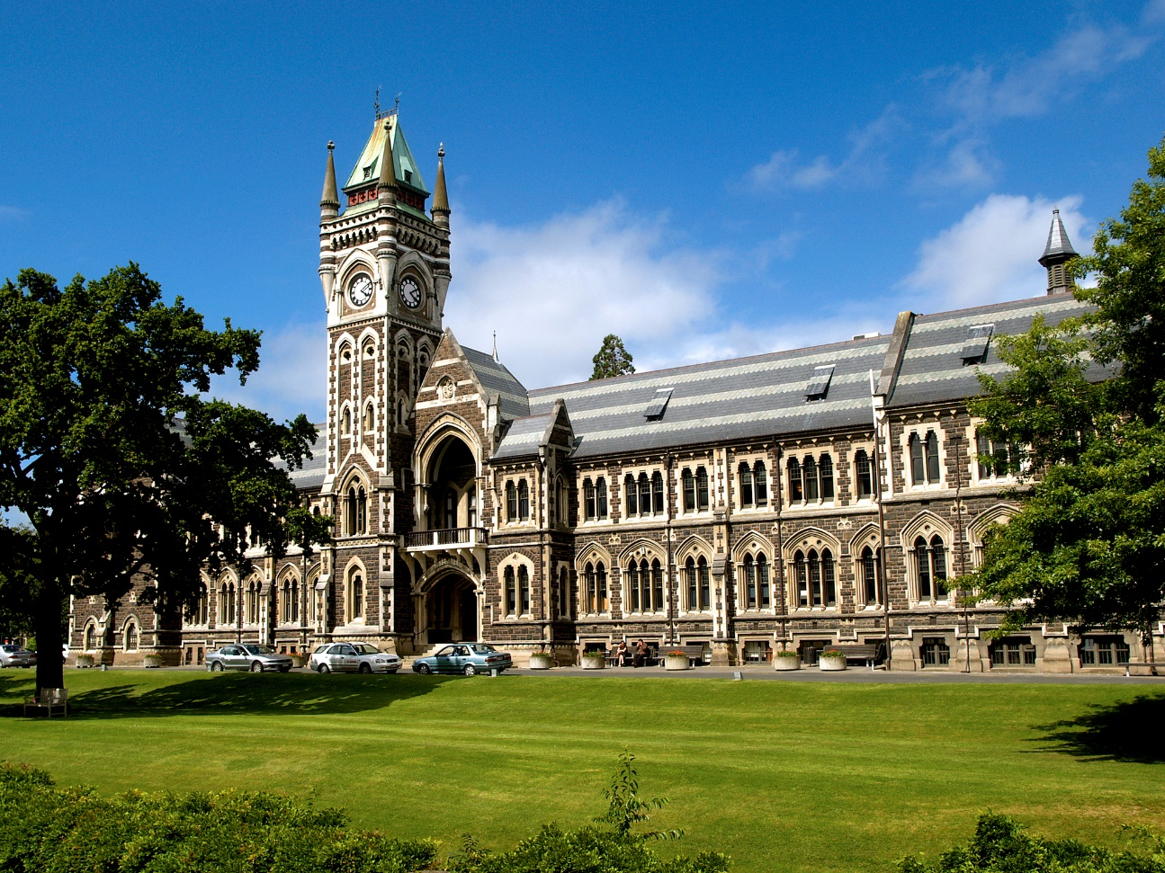
Ivory Tower University
Welcome to Admission Officer Training!

Slide 9
Ivory Tower University
Highly competitive admission
Seek a diverse student body
Consider personal attributes, such as:
evidence of impactful leadership
passion for public service
strength of character in overcoming personal hardships
First generation or under-represented students,
etc

Slide 10
Ivory Tower University
Last year’s admission profile:
Rank in class, by decile
1st | 39%
2nd | 13%
3rd | 6%
4th | 4%
5th | 3%
6th | 1%
7th | 0%
8th | 0%
9th | 0%
10th | 0%
Not reported | 34%
Applications | 35,000
Admission offers | 6,000
Admission rate | 17%
Expected enrollment | 4,200
Interquartile ranges | 25th %-ile | 75th %-ile
GPA | 3.82 | 4.20
SAT Critical Reading | 610 | 710
SAT Math | 620 | 760
SAT Writing | 600 | 720

Slide 11
Ivory Tower University
25 minutes to review cases
15 minute committee meeting to decide:
1 admit, 1 wait-list, 1 deny
5 minutes: what would we do?
15 minutes, discussion Q&A

Slide 12
Time to read
You are already behind.

Slide 13
Ivory Tower University
Results from each committee:
 | 1. Kyong "Angela" Park | 2. Soon-Yul "David" Kim | 3. Shu-fen "Jacqueline" Huang
Kirk | Deny | Admit | Wait
JoBeth | Wait | Admit | Deny
Jeffrey | Wait | Admit | Deny
Kara | Admit | Wait | Deny

Slide 14
What would we do?

Slide 15
Questions?

Slide 16
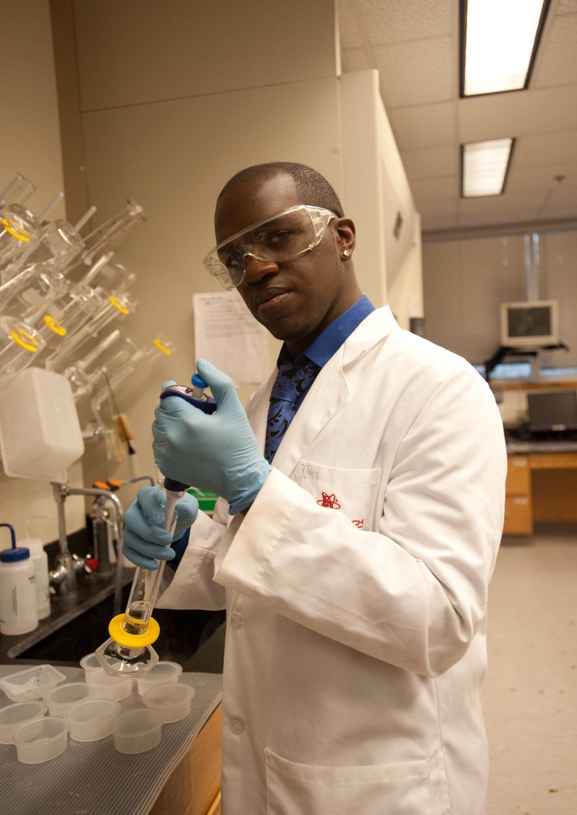
MORGAN STATE UNIVERSITY: A SNAPSHOT
Baltimore, Maryland, Founded in 1867
STUDENT ENROLLMENT
Undergraduate – 6,319; Graduate – 1,406
55% women; 45% men
78% from Maryland; 22% from out-of-state. Top feeder states: NY, NJ, DC, PA, VA with students from 65 countries;
80% full-time; 20% part-time
82% African American; 7% international; 3% white; 3% Hispanic; 1% Asian
Students receiving Financial Aid - 90%
DEGREE PROGRAMS
47 Baccalaureate programs
38 Master’s programs
16 Doctorate programs

Slide 17
Role of IB in Admissions Process
Acknowledgement that success in IB courses speaks to student’s ability to handle college level coursework
Recognition of the rigor of IB by awarding of university credit to students who successfully complete IB course work (up to 8 credits per course, depending on score).
Eligibility for Honors Scholarships

Slide 18
How an IB student is viewed…
A liberal arts education, in a number of ways, is similar to an IB education. Students are learning a wide variety of courses (such as the physical sciences, social sciences, humanities, the arts). Intellectual curiosity, social responsibility, international understanding are traits that students are learning in the IB now and will learn at a liberal arts institution.
The challenge aspect of an IB program also is viewed favorably at colleges. A student is taking a very rigorous level of classes/coursework (not just taking standard level or college prep work).

Slide 19
How an IB student is viewed…
Thinking “outside the box” issues…
Double-Major, Major/Minor degrees, ‘Student-Designed’ Major, Life-long Learning, etc.
These aspects are beneficial for an IB student as they apply to colleges, but also when they are in college and skill sets that they take with them once they leave college.

Slide 20
How an IB student is viewed…
IB students can handle the writing aspects of a liberal arts education (many classes have a number of essays and texts that students have to have good writing skills.
Research/senior capstone projects...students have that experience in their IB coursework, and can add to it as they enter college/university
Experiential Learning aspects (study abroad, internships/cooperative programs, community service connections)

